Slide 1

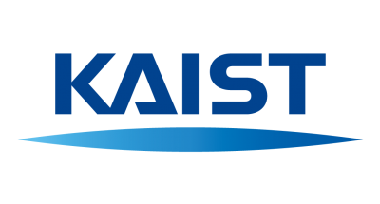
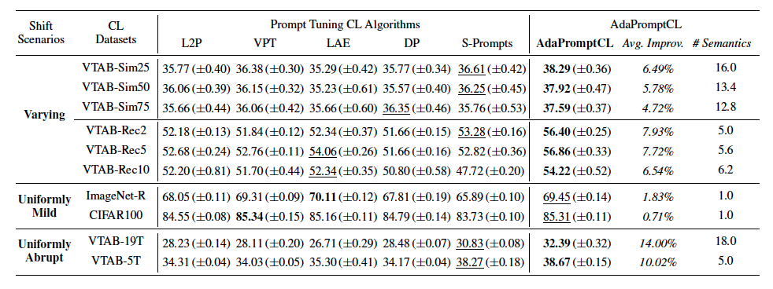

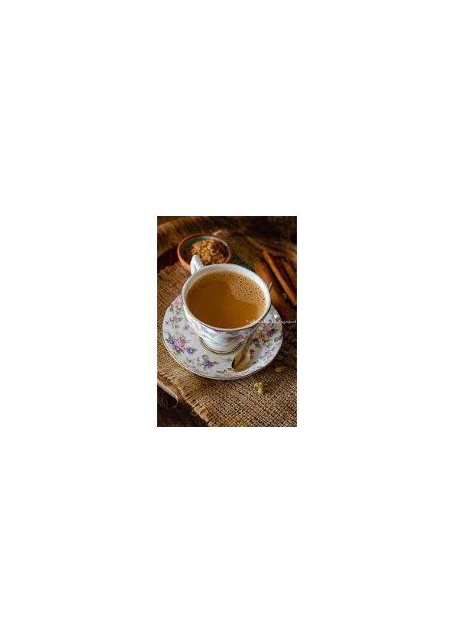
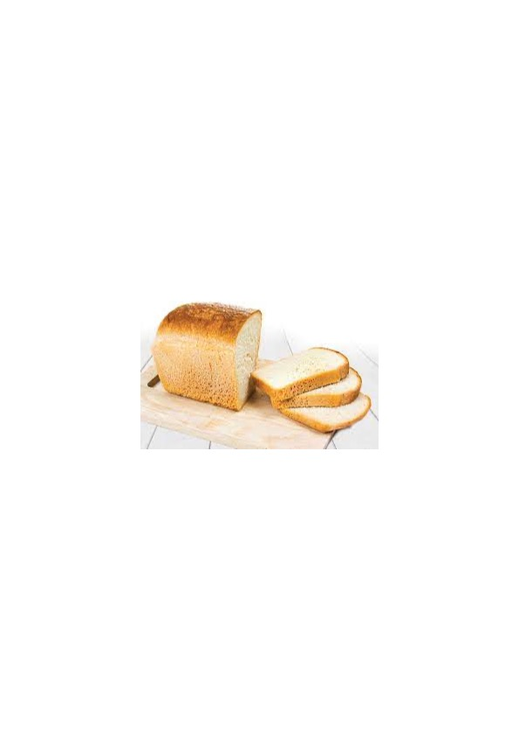
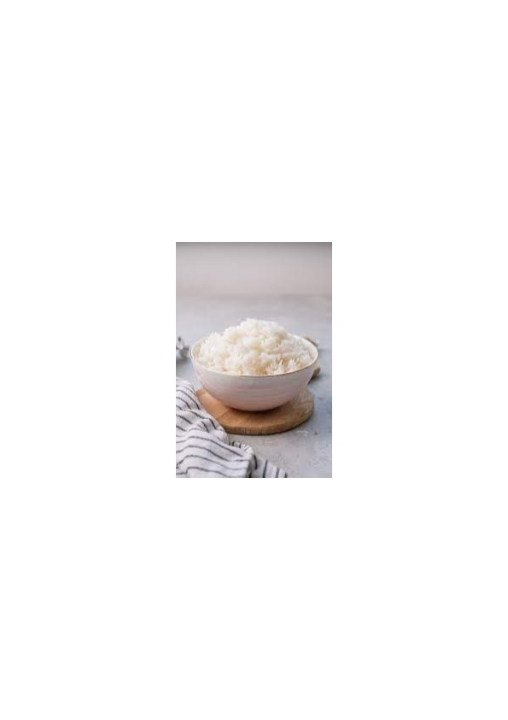
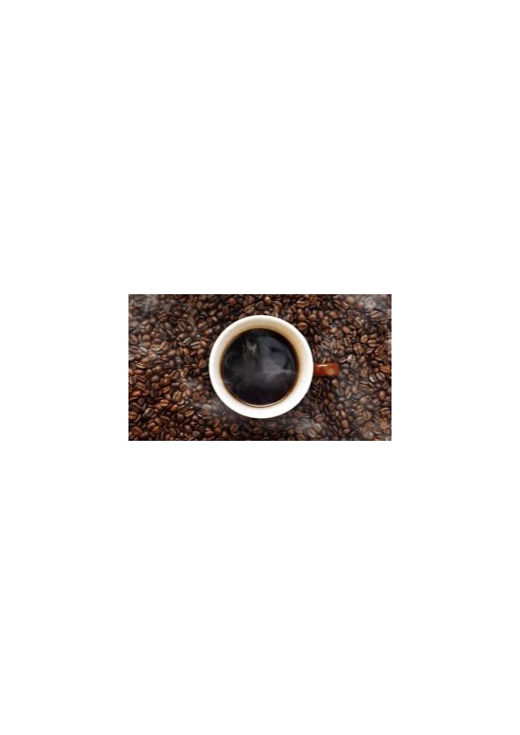


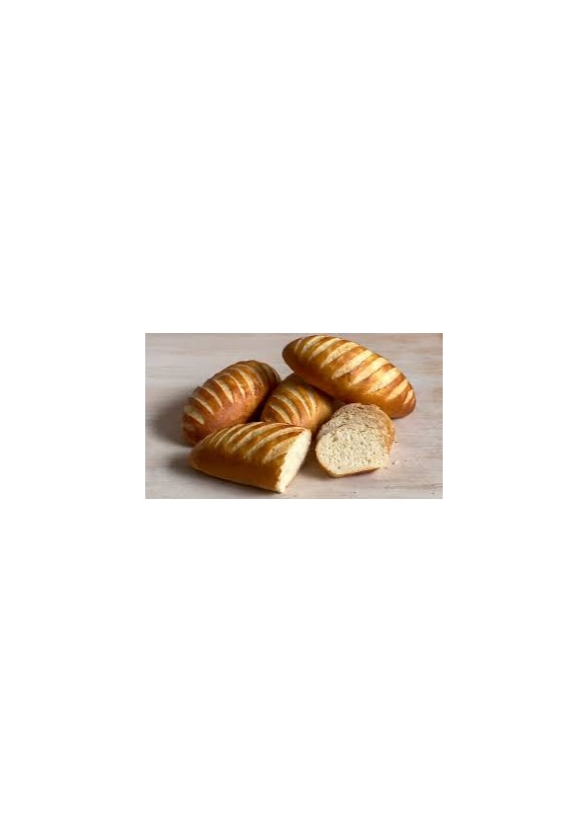


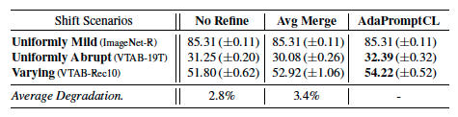
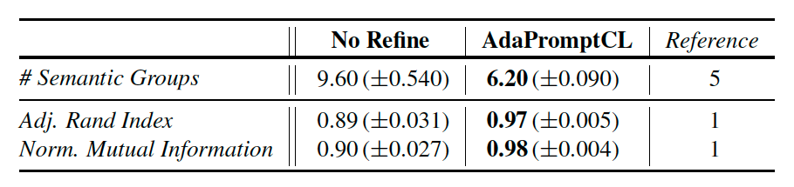


One Size Fits All for Semantic Shifts:
Adaptive Prompt Tuning for Continual Learning
Doyoung Kim, Susik Yoon, Dongmin Park, Youngjun Lee, Hwanjun Song, Jihwan Bang, Jae-Gil Lee
Continual Learning (CL)
Limitations of Existing Prompting Methods
Evaluation
Practical DNN learning scenario in real-world applications
CL methods mitigates stability-plasticity dilemma
Real-world CL scenarios: Varying degrees of semantic shifts
T1. Overall performance improvement by AdaPromptCL
Data distributions (“tasks”) changes arbitrarily over time
Universal prompting methods: Insufficient prompts
Specific prompting methods: Redundant prompts
→ Compromise forgetting prevention and knowledge transfer!
Task 1
Task 2
Task 3
Task
stream
Task A
Task B
Task C
…
Task F
Time
Ideally, two prompts
for two semantics
Mild shift
Abrupt shift
…
Universal
Prompting
One prompt
(instead of two)
Prompt
pools
Update
Specific
Prompting
Four prompt
(instead of two)
Only
model
Only
model
New
New
New
T2. Ablation study on refinement step
T3. Correctness of refinement
Learn continually!
Time
Limitations of existing prompting CL methods
Continual learning
Research Goal: Accommodating Varying Semantic Shifts
Rehearsal-Free CL
Key idea: Adaptive prompting via semantic grouping
(T1) AdaPromptCL consistently outperforms existing prompting methods
(T2) Refinement step is crucial for CL performance across various shifting scenarios
(T3) Refinement step is effective for refining inaccuracies in semantic grouping
Gained interest due to superior performance without using past data
Use small learnable parameters, known as prompts, to refine a pretrained model for various tasks
Update existing prompts for mild shifts
Introduce new prompts for abrupt shifts
Task
stream
Task A
Task B
Task C
…
Task F
Time
Visualization of Semantic Grouping
New Task
New
data
Frozen
Prompt
pools
Mild shift
Abrupt shift
…
Adaptive
prompting
Update
New
Keep
Adaptive prompting via semantic grouping
Prompt
Methodology: AdaPromptCL
Train prompts for new tasks
AdaPromptCL realizes accurate grouping via assign-and-refine process
Categorization Rehearsal-Free CL
When the semantic groups are undesirably specified by assigning similar tasks to different semantic groups (see X symbols around the green (G3) tasks), AdaPromptCL successfully refines overgeneration of semantic groups by correctly merging similar tasks (see X symbols).
Universal prompting methods: Train fixed set of prompts for all tasks
Specific prompting methods: Train specific prompt for each task
Task
stream
Task A
Task B
Task C
…
Task F
Conclusion & Contributions
Time
AdaPromptCL realizes adaptive prompting to effectively handle
diverse and unpredictable semantic shifts
Assign-and-refine grouping ensures precise prompting tailored to evolving task semantics
AdaPromptCL demonstrates its superior efficacy, highlighting its adaptability in real-world CL scenarios
…
Universal
Prompting
Detailed view of assign-and-refine grouping process
Prompt
pools
Update
Step I: Assignment step
Specific
Prompting
Add tasks to groups based on similarity
Store potential groups for future refinements
New
New
New
Step II: Refinement step
Comparison of existing prompting CL methods
Refine groups if better grouping is found

