Slide 1
Meta-Query-Net: Resolving Purity-Informativeness Dilemma in Open-set Active Learning
Dongmin Park (presenter), Yooju Shin, Jihwan Bang, Youngjun Lee, Hwanjun Song*, Jae-Gil Lee*
Data Mining Lab, KAIST
Notes:
Hello, I’m Dongmin Park from KAIST. Im gonna explain our paper named, Meta-query-net: Resolving purity-informativeness dilemma in open-set active learning, which will be published in NeurIPS 2022 soon.

Slide 2
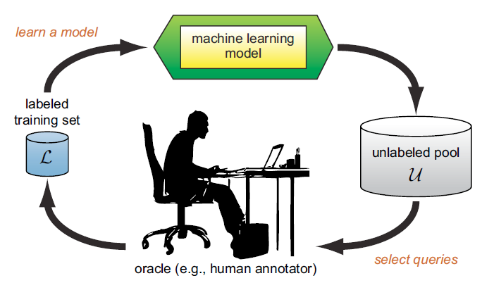
Active Learning
Goal: Maximizing the model performance while minimizing labeling costs
→ Querying the examples that look maximally-informative
“Making an AL algorithm = Making a good query strategy”
Notes:
Active Learning, a long and popular machine learning problem, aims at maximizing the model performance while minimizing the labeling costs, by incorporating a human labeler in the model training loop.
Generally, an active learner tries to select and label data examples from a large unlabeled pool, that looks maximally informative.
This process repeats for multiple rounds so that the size of training set gradually increase, with small but very informative examples

Slide 3
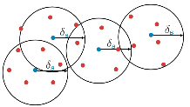
Summary of Standard AL Approaches
$$x_{LC}^{∗}=\underset{x}{argmax}{1−p_{θ}(\hat{y}|x)}$$
Uncertainty-based
Querying the example that is least certain by the current model
e.g., Softmax Confidence (CONF), Bayesian Disagreement (BALD), Learning Loss, …
Diversity-based
Querying the example that best represents the entire data distribution
e.g., Pre-clustering, Coreset, …
Hybrid
BADGE, BatchBALD, …
Coreset
Notes:
The existing standard active learning work can be mainly categorized into two approaches.
First, uncertainty-based approaches, that query the examples that is least certain to the current model.
Second, Diversity-based approaches, that query the examples that best represent the entire data distribution.
Many active learning algorithms have been developed and shown their effectiveness in terms of model accuracy within a labeling budget.

Slide 4
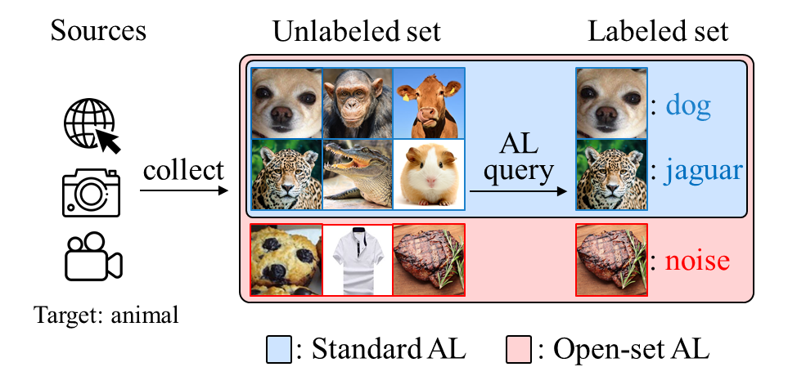
Open-set Active Learning: a more practical setup
An unlabeled set consists of only in-distribution examples? → NO
Unlabeled data collected from casual data curation processes, e.g., web-crawling, inevitably contains open-set noise, so called out-of-distribution (OOD) examples
useless for a target task
= waste of the labeling budget!
Notes:
However, these success of standard AL algorithms is only valid under the assumption that unlabeled set consists of only in-distribution examples.
For examples, like the blue box in the below figure, when we try to learn animal classifier by the AL framework, unlabeled set would contain only in-distribution animal examples, so that we can assign an animal label for each examples.
However, in practice, the unlabeled data is collected by a casual data curation process like web-crawling, inevitably containing open-set noise, so called out-of-distribution examples, like the red box in the figure.
These noise examples are useless for target task, which is just waste of the labeling budget.

Slide 5
Importance of Handling OOD in AL
OOD examples are usually uncertain & diverse, thus often being queried
This wastes the labeling budget and significantly degrades AL performance
Datasets: [In: CIFAR10, OOD: SVHN] , Noise Ratio : 50%
Random
CONF (Uncertainty)
Coreset (Diversity)
%
%
Test Accuracy
OOD Ratio in Query set
%
%
Rounds
Rounds
→ Hinders the usability of AL in real-world applications!
Notes:
Moreover, Handling the open-set noise, OOD examples, are very important in active learning.
Because, OOD examples are usually very uncertain in prediction and diverse in representation space, so likely to be queried by the standard uncertainty-based and diversity-based AL algorithms.
We conducted a simple experiment, comparing AL performance of a random selection with an uncertainty-based and a diversity-based approach, on CIFAR10 mixed with 50% of noise from SVHN data.
The result showed that two AL approaches were even worse than random selection because it queried too much OOD examples at the later AL rounds, which is waste of budget.
Thus, Handling OOD examples are very important for increasing usability of AL in real-world applications.

Slide 6
Recent Open-set AL Approaches
CCAL (ICCV'21)
Learns two contrastive learners for calculating informativeness and OODness, respectively
Combines the two scores into a final query score using a heuristic balancing rule
SIMILAR (NeurIPS’21)
Selects a pure and core set of examples by maximizing the distance coverage on the entire unlabeled data and jointly minimizing the distance coverage to the already labeled OOD data
→ Focus on increasing purity of a query set by effectively filtering out OOD examples
Notes:
Most recently, two approaches were proposed for this problem.
In common, both approaches try to increase the purity of query-set by effectively filtering out OOD examples using a heuristic and static balancing rule between example informativeness and OODness.

Slide 7
Purity-Informativeness Dilemma
“Should we focus on the purity throughout the entire AL period?”
Increasing Purity $↔$ Losing Informativeness → Trade-off!
The optimal trade-off changes according to AL rounds & noise ratios!
Notes:
However, whether we should focus on the purity throughout the entire active learning period remains a question
Purity scores, calculated from existing OOD detection research, have high correlations with informativeness scores in active learning,
That is, when we try to increase the purity of query-set, the informativeness per each examples in query-set decreases.
Also, it is questionable if more but less-informative examples are more beneficial than fewer but highly-informative examples for increasing model accuracy.
Interestingly, we found that a standard AL approach, LL[5], which puts more weight on the examples of high informativeness, improves the test accuracy more significantly than an open-set AL approach, CCAL [13], which puts more weight on those of high purity at the later AL rounds.
Furthermore, comparing a low OOD (noise) ratio in Figure 1(b) and a high OOD ratio in Figure 1(c), the shift from High Purity dominance to High Informativeness dominance occurs later at a higher OOD ratio.
This renders the dilemma more difficult, and calls a new method to find best balance between purity and informativeness over active learning rounds and varying noise ratios.

Slide 8
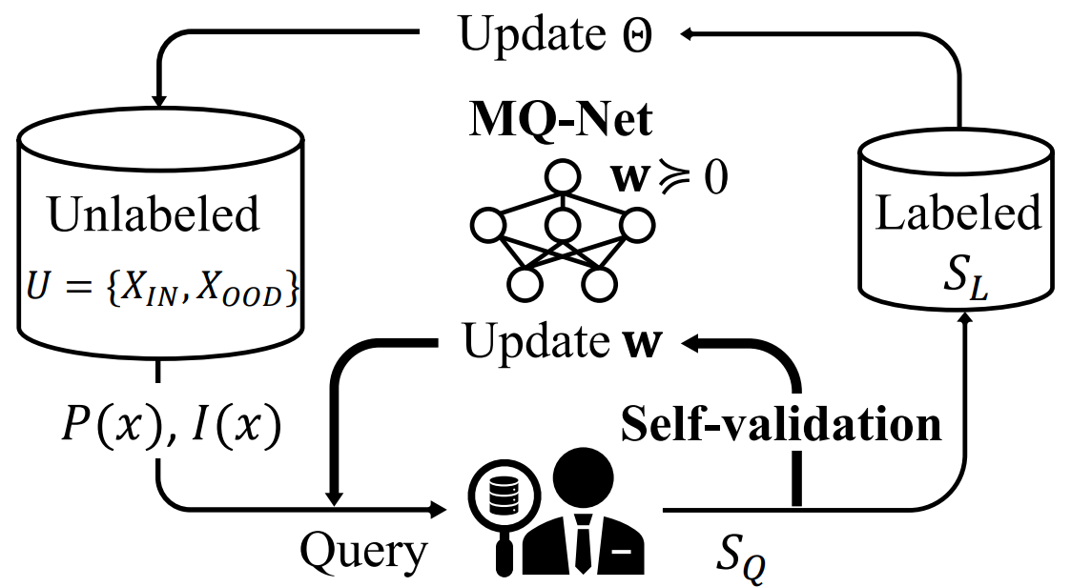
Meta-query-net (MQ-Net)
To find the best balance between purity and informativeness
Learns a meta query-score function $Φ(z_{x}; w)$
Uses each round’s query set as a self-validation set
Can incorporate most existing AL scores and OOD scores
Notes:
To do so, we propose a novel framework with a small multilayer perceptron based query function, which we call Meta-query-network
Figure shows the overall procedure of MQ-Net.
MQ-Net inputs any existing AL scores as informativeness and convert any OOD scores as purity, then outputs a scala query score for each examples.
It is trained by supervised-manner using each round’s query set as the self-validation set before they are added into the labeled set.

Slide 9
Objective of MQ-Net
IN>OOD
High loss first
From a query set $S_{Q}$ (unseen for $θ$)
Skyline regularization (to preserve order dominance w.r.t purity & informativeness)
Pairwise ranking loss according to the masked cross entropy
Output priority: 1) Informative IN examples first and 2) IN examples > OOD examples
Stable optimization with skyline regularization
Notes:
MQ-Net is trained based on the ranking loss which aims to match the output in the order of the masked cross entropy of each examples.
That is, for the output priority, it assign high score to the example with high masked cross entropy, meaning that it try to make Informative IN examples in the higher priority, and all IN examples in front of the OOD examples.
Moreover, if one example has higher value in terms of both purity and informativeness than an another example, the query score should preserve this order.
Thus, to preserver the order dominance we added a regularization term which we call skyline constraint.

Slide 10
Architecture of MQ-Net
$$⟹$$
Non-negative weights MLP
Preserving order dominance between two examples w.r.t. purity and informativeness
Being attributed to the properties of non-decreasing activation functions
[Implementation] Applying a ReLU function for each parameters $w$ (=differentiable)
→ Achieve the skyline constraint without any complex loss-based regularization!
Notes:
Simply, the skyline regularization can be solved by a special MLP architecture, with non-negative weights.
That is, for any MLP-based MQ-Net with non decreasing activation functions and non-negative weights, the skyline constraints holds.
This is attributed to the properties of non-decreasing functions which we theoretically proved in the paper.
As a result, we achieve the skyline constraint without any complex loss-based regularization.

Slide 11
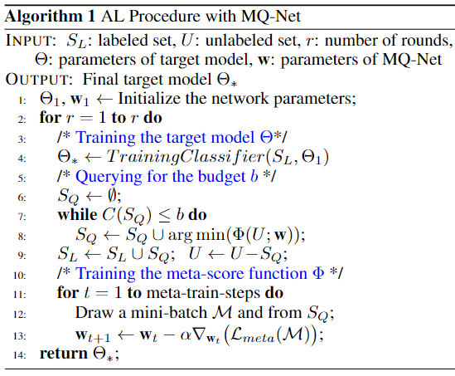
Active Learning with MQ-Net
Meta-input Conversion
Overall Procedure
Can incorporate any AL score $Q(x)$ and OOD score $O(x)$
$P\left(x\right)=Exp(Normalize(−O(x)))$
$I\left(x\right)=Exp(Normalize(Q(x)))$
Notes:
We can also provide how to incorporate existing AL scores and OOD detection scores into the MQ-Net with detailed algorithm pseudo-code.

Slide 12
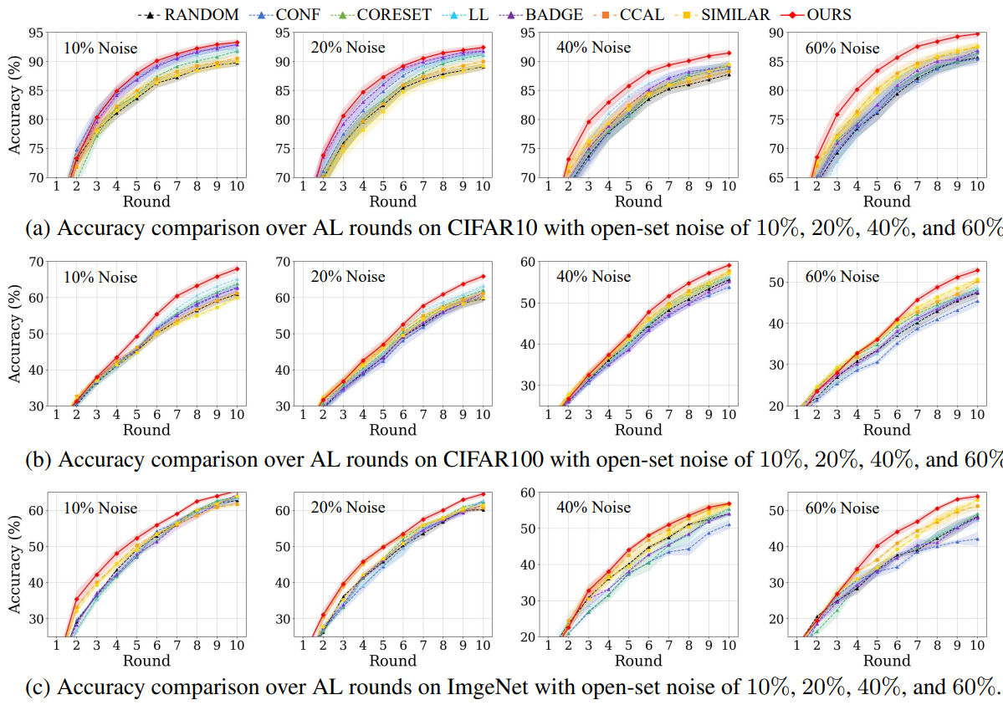
Experiments
On three datasets (CIFAR10, CIFAR100, ImageNet50) with varying noise ratios (10%, 20%, 40%, 60%)
MQ-Net achieves the best accuracy for all datasets
MQ-Net is the most robust to any noise ratios
In conclusion, MQ-Net finds the best trade-off between purity and informativeness
Notes:
We conducted extensive experiments on three datasets including CIFAR10, CIFAR100, ImageNet50 with varying noise ratios from 10% to 60%.
Overall, MQ-Net achieves the best accuracy for all datasets and noise ratios.
Which indicates that MQ-Net finds the best balancing between purity and informativeness.

Slide 13
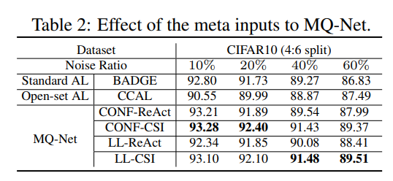
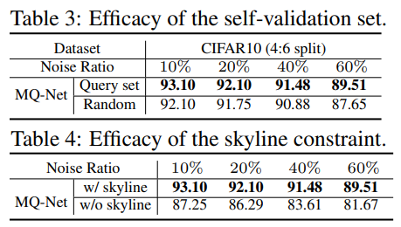
Takeaway & Ablation Studies
When the AL round progresses,
Purity (early) → Informativeness (late)
When the noise ratio increases,
Informativeness (small) → Purity (high)
Notes:
So, takeaway messages from MQ-Net are First, When active learning round proceeds, we should emphasize informativeness over purity, which means that fewer but informative examples are more helpful for improving the test accuracy at the later active learning rounds.
Second, when noise ratio increase, we should emphasize purity over informativeness, which implies that less informative but more examples are beneficial when noise ratio is high.
We also provide in-depth analysis of each module of MQ-Net using ablation studies, which includes effect of meta inputs, efficacy of self-validation set and skyline constraint.
More detailed result and analysis can be found in the paper.

Slide 14
THANK YOU Any Question?

