Slide 1
Temporal Convolutional Network-Based Time-Series Segmentation
Hyangsuk Min(presenter)^{1,2}, Jae-Gil Lee¹*
¹Data Mining Lab, KAIST
²M2MCx, HL Mando
Notes:
Hi, I’m Hyangsuk Min from KAIST and HL Mando.
Today, I’m gonna present the paper titled Temporal Convolutional Network based time series segmentation.

Slide 2
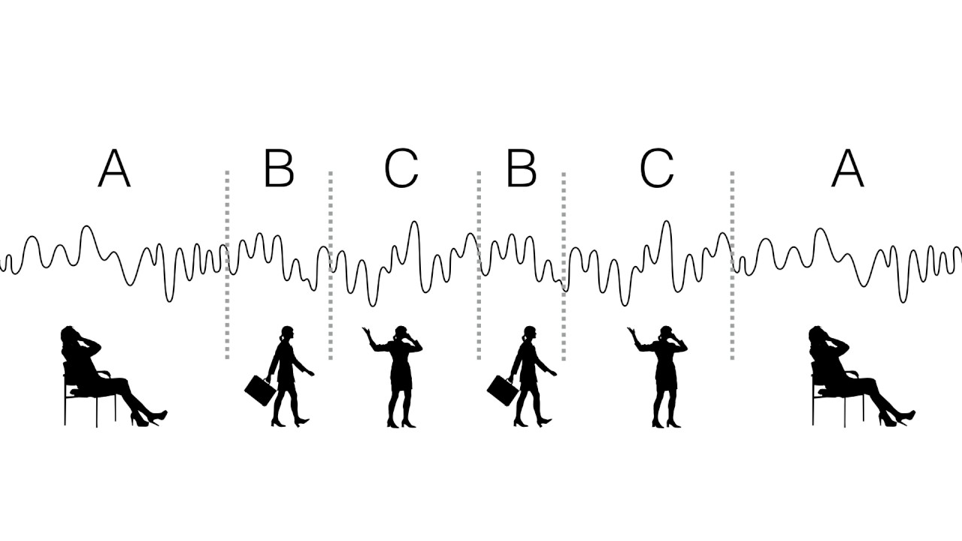
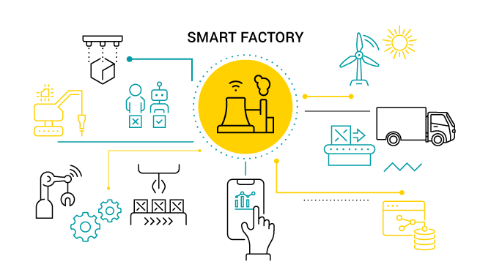
Introduction
01
Time Series
Time series are generated in various fields such as smart factories, automobiles, and health care monitoring.
These time series can be summarized as a sequence of states. ⟹ Time-series segmentation
< Time-series segmentation >
< Smart factory >
< Health care monitoring >
Fu, 2011; Fawaz et al., 2019
Notes:
Time series are generated in various fields such as smart factories, automobiles, and health care monitoring. These time series can be summarized as a sequence of states. Such as running and walking or going straight and turning left.
We can call this process as time-series segmentation.

Slide 3
Introduction
01
Time-Series Segmentation
Time-series segmentation:
Partitions time series into multiple segments.
Classifies them simultaneously.
Sequence of states
Standing
Jumping
Walking
Running
Repeated patterns
Repeated patterns
Notes:
In other words, time series segmentation is to partition time series into multiple segments and classify them at the same time.

Slide 4
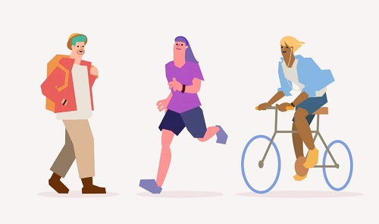
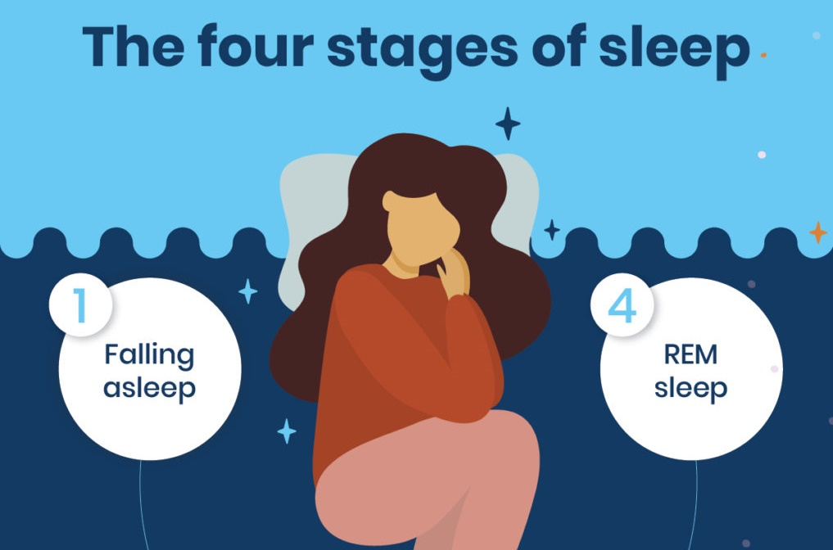
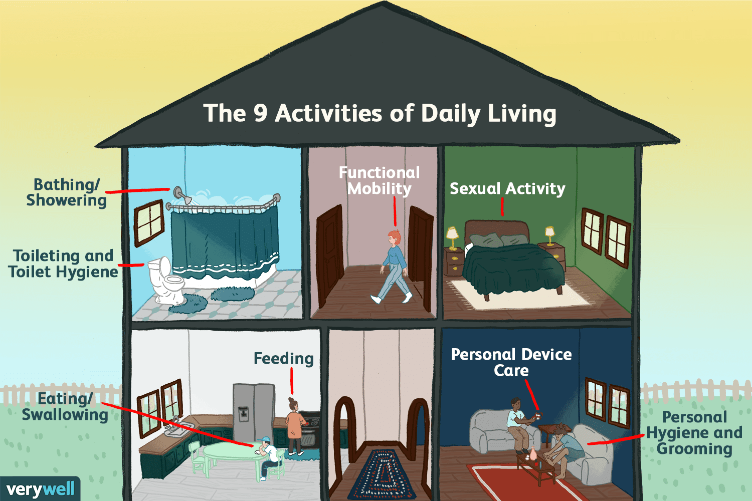
Introduction
01
Applications of Time-Series Segmentation
Fitness tracking
Network attack detection
Sleep stage analysis
Fault detection
Fawaz et al., 2019
Notes:
Time-series segmentation can be applied to various applications such as fitness tracking, sleep stage analysis and fault detection.

Slide 5
Introduction
01
Label Deficiency in Time-Series Segmentation
Labels for every time point are normally unavailable.
Manually annotating labels is human-labor intensive and inefficient.
Unsupervised time-series segmentation
?
?
?
?
?
?
< Label deficiency in time series>
Notes:
But there is a critical issue to apply time series segmentation to real life application. label deficiency problems. Labels for every time point are not normally available and manually annotating labels is human-labor intensive and inefficient.
So, we suggests time-series segmentation in unsupervised way.

Slide 6
Introduction
01
Related Work
($n$: # dimension of time series )
Gaussian mixture model (GMM) [ Liao, 2005]
Partitions time series by clustering $w$-length subsequence.
Estimates$Θ_{k}∈ℝ^{nw × nw}$, covariance matrix, to represent each state.
Toeplitz inverse covariance-based clustering (TICC) [Hallac et al., 2017]
Estimates $Θ_{k}∈ℝ^{nw × nw}$, inverse covariance matrix with Toeplitz constraints.
$w$-length subsequence ($x_{i}∈$ $ℝ^{n ×w}$)
$$w$$
$$w$$
$$x_{i+1}$$
$$x_{1}$$
$$x_{i}$$
$$x_{T−w}$$
$$x_{i−1}$$
$$Θ_{k}=\frac{\sum_{i=1}^{T−w}{p\left(z_{ik}=1|x_{i}\right)\left(x_{i}−μ_{k}\right){\left(x_{i}−μ_{k}\right)}^{T} }}{\sum_{i=1}^{T−w}{p\left(z_{ik}=1|x_{i}\right)}},$$
$where z_{ik} is whether N(μ_{k},Θ_{k}) is selected.$
$${argmax}_{k} ℒ(x_{i}, μ_{k},Θ_{k})$$
$$C$$
$$⋯$$
$$y_{i}$$
$$⋯$$
$$y_{1}$$
$$y_{i−1}$$
$$y_{i+1}$$
$$y_{T−w}$$
E-step: update $C$
M-step: estimate $μ_{k},Θ_{k}$
Notes:
There are previous works for unsupervised time-series segmentation, such as GMM and TICC.
Previous approaches simultaneously segment and cluster the time series without any labels.
Importantly, time series have temporal dependency, each time point is related to a previous time point. To consider temporal dependency, previous approaches cluster w-length subsequence instead of a single time point.
They use EM algorithms to cluster time-series. EM algorithms consists of two-steps and two steps are repeated until a certain condition is satisfied.
M step is to estimate the statistical properties, such as mean vectors and variance matrices, while E step is to update the optimal cluster of each subsequence using the properties which calculated in M step. When there are no more changes in E-step, the algorithm stops and they output the segment results.
There is an additional point that the longer subsequence length, the larger mean vector and variance matrices.
Subsequence vector, matrix -> size 언급. 뒤에 limitation과 연결하려면 필수 설명.
*model-based

Slide 7
Introduction
01
Limitations (1/3)
Standing & Jumping have a mixture of relatively short patterns.
Walking has a mixture of short and long patterns.
Running has a mixture of relatively long patterns.
$⟹$ It is necessary to adaptively learn varying length patterns.
Standing
Jumping
Walking
Running
Short patterns
Long patterns
Notes:
However, previous approaches have a limitation.
For example, we collected the time series for fitness tracking. Let’s assume a person stand for a while and starts to jump, walk and run. Intuitively we know, each behavior differs and generates different patterns of time series.
Standing and Jumping show different patterns, standing has a mixture of relatively shortly repeated patterns, while walking and running has a mixture of long patterns.
Thus, we can notice that time-series contains varying length patterns according to the states which cannot be easily captured by the pre-fixed subsequence. we necessarily need to learn varying patterns adaptively.

Slide 8
Introduction
01
Limitations (2/3)
Identifying varying length patterns is key to determining segmentation quality.
Using short subsequence (1) leads to fragmentation.
$⟹$It fails to properly grasp long patterns.
TICC
State-of-the-art
Ground truth
Standing
Jumping
Walking
Running
TICC
State-of-the-art
Using long subsequence (2) results in missing transition points.
$⟹$ It disregards short patterns.
Notes:
That is identifying varying length patterns is key to determining segmentation quality.
However, in the previous approaches, the subsequence length is fixed, it can not contain various length patterns. It causes several limitations.
First, using short subsequence leads to fragmentation, because it can not grasp long patterns, on the other hands, using long subsequence results in missing transition points cause it disregards short patterns.
There are critical trade-off to set the subsequence length.

Slide 9
Introduction
01
Limitations (3/3)
Previous approaches estimate a matrix whose size is given by the subsequence.
TICC needs $O(Kn^{2}w)$ parameters, and GMM needs $O(Kn^{2}w^{2})$ parameters.
( K = # of states, w = subsequence length, n = dimension of time series )
⟹ The longer the subsequence, the more parameters are required.
$$K$$
Standing
Jumping
Walking
Running
$$n$$
$$w$$
Notes:
Thirds, previous approaches takes longer time to have time-series segmented. Because they estimate a matrix whose size is given by the subsequence. If the subsequence gets longer, the estimation time takes more.

Slide 10
Introduction
01
Challenges
Previous approaches do not properly grasp varying length patterns which cause multiple challenges.
Short subsequence
Long subsequence
Causes to split a state into multiple meaningless fragments.
Results in missing transition points.
Leads to more parameters to learn.
How to (1) learn both short and long patterns (2) efficiently in an unsupervised way for time-series segmentation?
Notes:
Finally, previous approaches do not properly grasp varying length patterns which cause multiple challenges.
There are trade-off in subseuquence length, short subsequene causes to split at one segment into multiple meaningless fragments, while, long subseuqnce results in missing transition points and leads to more parameters to learn.
Therefore, we focus on how to learn both short and long patterns efficiently in an unsupervised way for time-series segmentation.

Slide 11
Methodology: TCTS
02
Problem Definition
$$⋯$$
$$x_{1}, x_{2}, ⋯$$
$$⋯,x_{T}$$
$$s_{1}:c_{1}$$
$${s_{2}: c}_{2}$$
$$s_{3}: c_{3}$$
$$⋯$$
$$s_{m}: c_{3}$$
Consider a time series $X∈ℝ^{T×N}$,
$$X=[x_{1} x_{2}⋯x_{T}],$$
where $x_{i}$ is the i-th observation, and $x_{i}=\{x_{i}^{1},x_{i}^{2}, …,x_{i}^{N}\}$ has N features.
The goal is to partition $X$ into non-overlapping segments$S=\left\{s_{1},s_{2},…, s_{m}\right\},$where the length of $s_{j}$ is arbitrary, and cluster S into K states $C=\left\{c_{1},c_{2}, …, c_{K}\right\},$where $c_{k}=\left\{s_{1},…, s_{n}\right\}$.
Notes:
Before get into the methodology, let me descr
Consider a time series X, where x is the i-th observation, and x has N features,
The goal is to partition X into non-overlapping segements S where the length of s is arbitrary and cluster S into K states.

Slide 12
Methodology: TCTS
02
Overview
Module 1: TCN-Based Pattern Learning
$$X^{1}$$
$${X^{1}}^{′}$$
$$X^{2}$$
Encoder
$$z_{latent}$$
Decoder
$${X^{2}}^{′}$$
$$X^{3}$$
$${X^{3}}^{′}$$
Clustering
Classification
$$\hat{y^{′}}$$
$$\hat{y}$$
Module 2: Clustering-Based Classification
Notes:
This is the overall architecture of the methodology we proposed.
The model is composed to two module, TCN-based pattern learning and Clustering-based classification to overcome the challenges.

Slide 13
Methodology: TCTS
02
Module 1: TCN-Based Pattern Learning
Module 1 learns varying length patterns using TCN with a pooling network.
$$L_{recon}=\frac{1}{T}\sum_{t=1}^{T}{{\left(x_{t}−x_{t}^{′}\right)}^{2}}$$
Temporal convolutional network (TCN)
$${X^{1}}^{′}$$
$${X^{2}}^{′}$$
Dilated Convolutional Layer
$${X^{3}}^{′}$$
$$⋯$$
$$+$$
$$z_{main}$$
Dilated Convolutional Layer
$$z_{latent}$$
$$Convolutional Layer$$
$$Convolutional Layer$$
$$Convolutional Layer$$
$$z_{sub}$$
$$X^{1}$$
Pooling & Up-sampling
$$X^{2}$$
$$⋯$$
$$+$$
$$X^{3}$$
Pooling & Up-sampling
Time series
Pooling network
Encoder network
Decoder network
Notes:
The first module, TCN-based Pattern leaning considers varying length patterns using TCN with a pooling network,
Module1 contains encoder and decoder network.
Encoder network gets the time-series as an input and generate the latent representation for time-series.
and the decoder network generate the original time-series using the latent representation.
The latent representation has the same length with time-series, so each point is corresponding to the time point in time-series.
and each point learns the temporal dependency and the varying length patterns.

Slide 14
Methodology: TCTS
02
$${X^{1}}^{′}$$
Detail of Module 1: Encoder
Temporal convolutional network (TCN)
Dilated Convolutional Layer
$${X^{2}}^{′}$$
$$⋯$$
$$+$$
$${X^{3}}^{′}$$
Temporal convolutional network (TCN)
Dilated Convolutional Layer
$$z_{main}$$
$$z_{latent}$$
$$Convolutional Layer$$
$$Convolutional Layer$$
$$z_{sub}$$
$$Convolutional Layer$$
Pooling & Up-sampling
$$⋯$$
$$+$$
Input
Dilated Convolutional Layer 1
Pooling & Up-sampling
Dilated Convolutional Layer 2
Pooling network
1D Dilated Convolutional Layer
Encoder network
Decoder network
$$⋯$$
Batch Normalization
Dropout
Dilated Convolutional Layer $ℓ$
$$+$$
1D Convolutional Layer
ReLU
$$⋯$$
$$⋯$$
$$z_{main}$$
Output
Dilated Convolutional Layer L
The receptive field of the dilated convolutional layer is $2^{ℓ+1}−1$. (when the kernel size is 3 and the dilation rate is doubled.)
The results of the layers are transformed by a 1D convolutional layer. $⟹$ A diverse length receptive field allows learning varying length patterns.
Lea et al., 2017
Notes:
TCN is composed of multiple dilated convolutional layers. The receptive filed of the dilated convolutional layer differs, so each layer covers diverse length subsequence and learn varying length patterns.
All the layers outputs are used and transformed by a 1D convolutional layer to learn representation for time-series.

Slide 15
Methodology: TCTS
02
$${X^{1}}^{′}$$
Detail of Module 1: Encoder
Temporal convolutional network (TCN)
Dilated Convolutional Layer
$${X^{2}}^{′}$$
$$⋯$$
$$+$$
$${X^{3}}^{′}$$
$$z_{main}$$
Pooling network
Dilated Convolutional Layer
$$z_{latent}$$
$$Convolutional Layer$$
$$Convolutional Layer$$
$$z_{sub}$$
$$Convolutional Layer$$
Pooling & Up-sampling
Input
$$⋯$$
$$+$$
Pooling & Up-sampling
Max Pooling (pool size = T )
Pooling network
Up-sampling ( size = T )
Encoder network
Decoder network
$$⋯$$
$$+$$
$$z_{sub}$$
Max Pooling (pool size = T/ 16)
Up-sampling ( size = T/ 16 )
A pooling network helps to stably learn representation.
A pooling network consists of multiple Max pooling and Up-sampling layers with a different pool size and an up-sampling factor.
A pooling network smoothens the time series and provides its general trend.
Singhania et al., 2021
Notes:
Next, the pooling network is to help learn representation for time-series stably. It smoothens the times series and provides its general trend. It consists of multiple max pooling and up-sampling layers with a different pool size and up-sampling factor.

Slide 16
Methodology: TCTS
02
$${X^{1}}^{′}$$
Detail of Module 1: Decoder
Temporal convolutional network (TCN)
Dilated Convolutional Layer
$${X^{2}}^{′}$$
$$⋯$$
$$+$$
$${X^{3}}^{′}$$
$$z_{main}$$
Decoder
Dilated Convolutional Layer
$$z_{latent}$$
$$Convolutional Layer$$
$$Convolutional Layer$$
$$z_{sub}$$
$$Convolutional Layer$$
Pooling & Up-sampling
Input
$$⋯$$
$$+$$
Pooling & Up-sampling
1D Convolutional Layer
Pooling network
Batch Normalization
$$Convolutional Layer$$
Encoder network
Decoder network
Dropout
ReLU
$$Convolutional Layer$$
Output
$$Convolutional Layer$$
The decoder network regenerates the original time series.
A convolutional layer is powerful to gather temporally spread information efficiently.
Notes:
The decoder is composed of multiple convolutional layer and regenerate the original time-series which help to learn time-series representation.

Slide 17
Methodology: TCTS
02
Overview
Module 1: TCN-Based Pattern Learning
$$X^{1}$$
$${X^{1}}^{′}$$
$$X^{2}$$
Encoder
$$z_{latent}$$
Decoder
$${X^{2}}^{′}$$
$$X^{3}$$
$${X^{3}}^{′}$$
Clustering
Classification
$$\hat{y^{′}}$$
$$\hat{y}$$
Module 2: Clustering-Based Classification
Notes:
Next, module2 clustering-based classification.

Slide 18
Methodology: TCTS
02
Module 2: Clustering-Based Classification
Module 2 improves $z_{latent}$to be helpful for segmentation.
Any clustering algorithms such as k-means and TICC can be used.
$$z_{latent}$$
Classification
Clustering
FCN
FCN
$$\hat{y^{′}}$$
$$L_{cls}=\frac{1}{T}\sum_{t=1}^{T}{\left(−\sum_{i=1}^{k}{{\hat{y^{′}}}_{t,i}}⋅\log{{\hat{y}}_{t,i}}\right)}$$
$$\hat{y}$$
Notes:
The second module, clustering-based classification improves representation of time series to be helpful for time series segmentation. As we know each segment has different features, thus we make the latent representation for time-series to be more separable by the power of the clustering.
Any clustering algorithms can be applied. We use classification layers to apply the power of the clustering to the latent representation.

Slide 19
Methodology: TCTS
02
Objective Function
$$L=λ∗L_{recon}+\left(1−λ\right)∗L_{cls}$$
$$L_{recon}=\frac{1}{T}\sum_{t=1}^{T}{{\left(x_{t}−x_{t}^{′}\right)}^{2}}$$
$$L_{cls}=\frac{1}{T}\sum_{t=1}^{T}{\left(−\sum_{i=1}^{k}{{\hat{y^{′}}}_{t,i}}⋅\log{{\hat{y}}_{t,i}}\right)}$$
$$λ is a regularization term to balance between two losses.$$
Notes:
The obejective function is composed of two losses.
First one, reconstruction loss from the module1 and second one classification loss from the module 2.

Slide 20
Evaluation
03
Datasets
mHealth [Banos et al., 2014]
Comprises body motion and vital signs recording while performing physical activities, such as standing, sitting, and climbing stairs.
PAMAP2 [Reiss et al., 2012]
Contains body motion while performing 12 different physical activities, such as walking, cycling, and running.
SKODA [Stiefmeier et al., 2008]
Comprises assembly-line workers' movement in a car production scenario, such as opening the engine bonnet, and checking the boot.
Datasets | # of Samples | Dimensions | # of States | Segment Length
mHealth | 35174 | 23 | 12 | [1075, 3379]
PAMAP2 | 51843 | 51 | 12 | [962, 6577]
SKODA | 107951 | 60 | 8 | [5872, 14680]
Notes:
We use three open-datasets, mHealth, PAMAP2, and SKODA.

Slide 21
Evaluation
03
Evaluation Metrics
Normalized Mutual Information (NMI)
$NMI\left(Y,C\right)=\frac{2×I(Y;C)}{[H\left(Y\right)+H(C)]},$ $where I\left(Y;C\right)=H\left(Y\right)−H\left(Y | C\right),$ $H\left(Y\right)=−Σ_{i=1}^{k}P\left(y_{i}\right)⋅\log{P\left(y_{i}\right)}$
Adjusted Rand Index (ARI)
$ARI\left(Y,C\right)=\frac{RI\left(Y,C\right)−E\left(RI\left(Y, C\right)\right)}{Max\left(RI\left(Y,C\right)\right)−E\left(RI\left(Y,C\right)\right)}, where RI\left(Y,C\right)=\frac{\# of Agreeing Pairs}{\# of Pairs}$
Accuracy (ACC)
$Accuracy=\frac{TP+ TN}{TP+FP+TN+FN}$
F1 score (F1)
$F_{1} score=2⋅\frac{Precision×Recall}{Precision+Recall}, where Precision=\frac{TP}{TP+FP}, Recall=\frac{TP}{TP+FN}$
Zhang et al., 2006; Ma et al., 2019
Notes:
The evaluation metrics are NMI and ARI which are for clustering, and ACC and F1.

Slide 22
Evaluation
03
Baselines
Time-series segmentation with raw value
k-means [Tavenard et al., 2020]: Clustering subsequence using k-means with Euclidean distance metric.
k-DBA [Petitjean et al., 2011]: A variant of k-means with DTW distance metric.
GMM [Liao et al., 2005]: Clustering subsequence using GMM.
TICC [Hallac et al., 2017]: A variant of GMM with Toeplitz inverse covariance.
Time-series segmentation with auto-encoder
Auto-encoder (AE) [Srivastava et al., 2015]: LSTM-based encoder network & decoder network.
AE + [Clustering]: Clustering a time point through a given clustering algorithm.
AE + k-means
AE + k-DBA
AE + GMM
AE + TICC
Notes:
The baselines are time-series segmentation algorithm with raw value and time-series segmentation with time series representation learned by the auto-encoder.

Slide 23
Evaluation
03
Overall Performance (1/2)
k-means
k-DBA
GMM
TICC
TCTS (Ours)
1.0
mHealth
0.0
1.0
PAMAP2
0.0
1.0
SKODA
0.0
NMI
ARI
F1
ACC
Notes:
We found that our model, TCTS shows the best results among the time series segmentation with raw values.
We can notice that learning the varying length patterns are important for time-series segmentation.
Especially, SKODA shows the huge increasement, cause SKODA contains both very short patterns and long patterns than other datasets.

Slide 24
Evaluation
03
Overall Performance (2/2)
AE + k-means
AE + k-DBA
AE + GMM
AE + TICC
TCTS (Ours)
1.0
mHealth
0.0
1.0
PAMAP2
0.0
1.0
SKODA
0.0
NMI
ARI
F1
ACC
Notes:
Comparing with the time-series segmentation with the latent representation learned by auto-encoder, our model shows much better performance.
We use the LSTM in auto-encoder to learn the latent representation which is widely used for time-series analysis. However, LSTM can learn temporal dependency well, however, it is not capable of learning various length patterns.

Slide 25
Evaluation
03
Segmentation Results
Ground truth
TCTS
mHealth
k-means
GMM
TICC
AE + TICC
Discover transition points accurately.
Prevent fragmentation problems.
Ground truth
SKODA
TCTS
k-means
GMM
TICC
AE + TICC
Notes:
Also the qualitatively, the segmentation results show that we prevent fragmentation problems, and transition points accurately then the baselines.

Slide 26
Evaluation
03
Efficiency
 |  | Params | Converged Time
mHealth | TCTS | $6.9K$ | 96s
 | TICC | $28.7K$ | 418s
PAMAP2 | TCTS | $$14.4K$$ | 193s
 | TICC | $$140.7K$$ | 1398s
SKODA | TCTS | $$15.0K$$ | 200s
 | TICC | $$129.8K$$ | 1177s
TCTS uses 3.2 times ~ 8.7 times fewer parameters compared to TICC, and its running time is much shorter.
Notes:
Also, TCTS much faster than TICC and uses less number of parameters.

Slide 27
Evaluation
03
Ablation Study of Module 2
We conduct two different versions of TCTS.
TCTS w/o Module 2 removes the classification layer and breaks joint updates between Module 1 and Module 2.
k-means algorithm is adopted in Module 2 instead of TICC.
TCTS w/o Module 2
TCTS w/ k-means
TCTS w/ TICC (Ours)
1.0
mHealth
0.0
1.0
PAMAP2
0.0
1.0
SKODA
0.0
NMI
ARI
F1
ACC
Notes:
We also had an ablation study of module2.
We use viaous clustering algorithms in module2.
Comapring to our model without module2, our model shows better results.
Also, any clustering algorithms shows better than without module2.
We can figure out that using the power of the clustering helps to segment time-series.

Slide 28
Conclusion
04
Conclusion
We propose a novel unsupervised time-series segmentation, called TCTS, which is aware of a mixture of both short and long patterns.
We demonstrate that TCTS can efficiently find distinct patterns adaptively for the states by utilizing the intermediate layers of TCN. Additionally, we adopt pooling networks to support TCN and clustering-based classification to make the representation suitable for clustering.
We show that TCTS improves the quality and accuracy of segmentation on multiple datasets in terms of NMI by 17% ~ 130% and ACC by 27% ~ 142%.
Notes:
Conclusion is ~ .

Slide 29
Introduction
01
Contributions
We propose a novel unsupervised time-series segmentation called Temporal Convolutional network-based Time-series Segmentation, TCTS, which is aware of varying length patterns inherent in time series.
We introduce TCN-based pattern learning to learn distinctive patterns depending on states and improve efficiency.
We show that TCTS outperforms baselines on multiple benchmark time-series datasets.

Slide 30
Reference
References
[1] Tak-chung Fu. A review on time series data mining. Engineering Applications of Artificial Intelligence, 24(1). 2011.
[2] Hassan Ismail Fawaz, Germain Forestier, Jonathan Weber, Lhassane Idoumghar, and Pierre-Alain Muller. Deep learning for time series classification: a review. DKDM, 33(4). 2019
[3] T Warren Liao. Clustering of time series data—a survey. Pattern Recognition, 38(11). 2005.
[4] David Hallac, Sagar Vare, Stephen Boyd, and Jure Leskovec. Toeplitz inverse covariance-based clustering of multivariate time series data. KDD. 2017.
[6] Colin Lea, Michael D Flynn, Rene Vidal, Austin Reiter, and Gregory D Hager. Temporal convolutional networks for action segmentation and detection. CVPR. 2017.
[7] Shaojie Bai, J Zico Kolter, and Vladlen Koltun. An empirical evaluation of generic convolutional and recurrent networks for sequence modeling. arXiv. 2018.
[8] Dipika Singhania, Rahul Rahaman, and Angela Yao. Coarse to fine multi-resolution temporal convolutional network. arXiv. 2021.
[9] Oresti Banos, Rafael Garcia, Juan A Holgado-Terriza, Miguel Damas, Hector Pomares, Ignacio Rojas, Alejandro Saez, and Claudia Villalonga. mhealthdroid: a novel framework for agile development of mobile health applications. IWAAL. 2014.
[10] Attila Reiss and Didier Stricker. Introducing a new benchmarked dataset for activity monitoring. ISWC. 2012.
[11] Thomas Stiefmeier, Daniel Roggen, Georg Ogris, Paul Lukowicz, and Gerhard Tr ̈oster. Wearable activity tracking in car manufacturing. IEEE Pervasive Computing, 7(2). 2008.
[13] Hui Zhang, Tu Bao Ho, Yang Zhang, and M-S Lin. Unsupervised feature extraction for time series clustering using orthogonal wavelet transform. Informatica, 30(3). 2006.
[12] Qianli Ma, Jiawei Zheng, Sen Li, and Gary W Cottrell. Learning representations for time series clustering. NeurIPS. 2019.
[13] Romain Tavenard, Johann Faouzi, Gilles Vandewiele, Felix Divo, Guillaume Androz, Chester Holtz, Marie Payne, Roman Yurchak, Marc Rußwurm, Kushal Kolar, et al. Tslearn, a machine learning toolkit for time series data. JMLR, 21(118). 2020.
[14] Fran ̧cois Petitjean, Alain Ketterlin, and Pierre Gan ̧carski. A global averaging method for dynamic time warping, with applications to clustering. Pattern Recognition, 44(3). 2011.
[15] Nitish Srivastava, Elman Mansimov, and Ruslan Salakhudinov. Unsupervised learning of video representations using lstms. ICML. 2015.

Slide 31
Thank you

Slide 32
Appendix
A
Temporal convolutional network (TCN)
TCN can learn long patterns with fewer parameters.
Intermediate layers can contain both short and long patterns since the kernel receptive field differs. (Kernel receptive field = $2^{ℓ+1}−1$, where $ℓ$ is a layer number.)
Kernel receptive field
Input
Output
$$x_{0}$$
$$x_{1}$$
$$x_{2}$$
$$⋯$$
$$x_{T−1}$$
$$x_{T}$$
Learn short patterns
$$d=2^{0}$$
$$d=2^{1}$$
Dilated convolutional layers
(d = space between the kernel)
$$d=2^{2}$$
Learn long patterns
$$d=2^{3}$$
Lea et al., 2017; Bai et al., 2018

Slide 33
Appendix
A
Overall Framework
$$X$$
(1) Time series input
$$\text{(4)} L_{recon}(X, X^{′})$$
$$X′$$
(2) TCN
(2) Pooling network
Module 1
$$z_{latent}$$
(3) Decoder
Repeat (1) ~ (4)
until $\hat{y}′$ does not change.
$$L(X)$$
update
Module 2
(3) Clustering
(3) Classification
$$\hat{y}′$$
$$\hat{y}$$
(4) $L_{cls}(\hat{y}′,\hat{y})$
(5) Segmentation output
$$S$$
Notes:
The overall framework is described.
Firstly, the timeseries X is going into the module 1 and the output for the module one which is the representation of time series go throught module 2 to have the dictinctive power from clustering and the representation is updated by module 1 and module2.
The process is repeated until the results of clustering does not changes.

Slide 34
Appendix
A
Result of Representation Learning
TCTS generates the representation to be distinct between states.
TCTS summarizes (b) to have a separate representation between states.
1.0
0.5
(a) Raw dataset
0.0
(b) Latent representation
(c) Ground truth
(d) Time-series segmentation results of TCTS

Slide 35
EOF

