Slide 1
BMVC 2021
Exploiting Scene Depth for Object Detection with Multimodal Transformers
Hwanjun Song , Eunyoung Kim , Varun Jampani , Deqing Sun , Jae-Gil Lee , Ming-Hsuan Yang
1
2
2
2
3
2
1
2
3

Slide 2
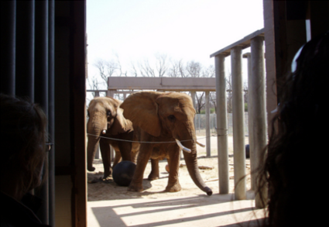
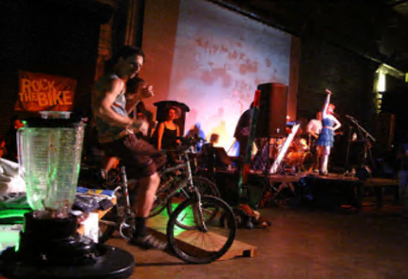
Research Goal
Depth information can be a clue invariant to color or lighting
But, acquiring ground-truth depth at scale still remains a challenge
An expensive and time-consuming task, requiring physical sensors
(a) Ambiguous color
(b) Varying lighting
Exploiting Scene Depth for Object Detection with Multimodal Transformers
2

Slide 3
Research Goal
Leverage inferred depth with available large-scale RGB data
Complement RGB information for object detection
Exploiting Scene Depth for Object Detection with Multimodal Transformers
3

Slide 4
Outline
General RGB-D Detection Pipeline <<
Three Challenges
Proposed Detection Pipeline: MEDUSA
Experimental Results
Conclusion and Future Work
Exploiting Scene Depth for Object Detection with Multimodal Transformers
4

Slide 5
General RGB-D Detection Pipeline
Three design choices to build a RGB-D Detector
RGB Image (3-channel)
(2)
(3)
Feature Extractor
(RGB-D Fusion)
Object Detector
(1)
Depth Encoding
Depth Map (1-channel)
1- or 2- stream structure
(Early and late fusion)
SVM, R-CNN, Faster-RCNN, …
*
Direct use or HHA
*
HHA is a depth encoding consisting of horizontal disparity, height above ground, and norm angle
Exploiting Scene Depth for Object Detection with Multimodal Transformers
5

Slide 6
RGB-D Fusion | Early and Late Fusion
Early Fusion
Late Fusion
“1-stream”
RGB
Feature
Extractor
Object
Detector
Depth
4-channel
“2-stream”
Feature
Extractor
RGB
Object
Detector
Feature
Extractor
Depth
Exploiting Scene Depth for Object Detection with Multimodal Transformers
6

Slide 7
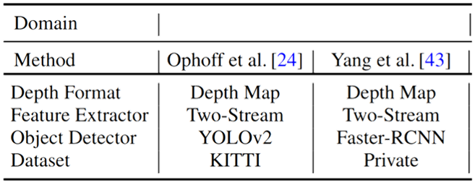
Existing RGB-D Detection Methods
Comparison according to the three design choices, (1)-(3)
Indoor Scenario
(1)
(2)
(3)
Car Driving Scenario
Study small-scale RGB-D detection, covering a specific narrow domain
Use simple RGB-D fusion approaches
(1)
(2)
(3)
Exploiting Scene Depth for Object Detection with Multimodal Transformers
7

Slide 8
Detailed Research Goals
Cover diverse scenarios by leveraging large-scale RGB data and its estimated depth
Propose a better RGB-D fusion approach using Transformer architecture
Exploiting Scene Depth for Object Detection with Multimodal Transformers
8

Slide 9
Outline
General RGB-D Detection Pipeline
Three Challenges <<
Proposed Detection Pipeline: MEDUSA
Experimental Results
Conclusion and Future Work
Exploiting Scene Depth for Object Detection with Multimodal Transformers
9

Slide 10
C1: Simple RGB-D Fusion
Simple fusion before and after the feature extraction phase
Sub-optimal to capture the nonlinear correlation
+
or
RGB
Depth
RGB-D
RGB-D
(a) Explicit Fusion
(b) Implicit Fusion
Exploiting Scene Depth for Object Detection with Multimodal Transformers
10

Slide 11
C2: Low Compatibility with Pretrained Models
The use of pre-trained model is essential in object detection
E.g., ResNet pretrained on ImageNet
Not fully compatible with the pretrained model
Architectural change to support 4- or 1-channel input
No pretrained model for the depth input
“2-stream”
Feature
Extractor
4-channel
“1-stream”
3-channel
Feature
Extractor
Feature
Extractor
1-channel
Exploiting Scene Depth for Object Detection with Multimodal Transformers
11

Slide 12
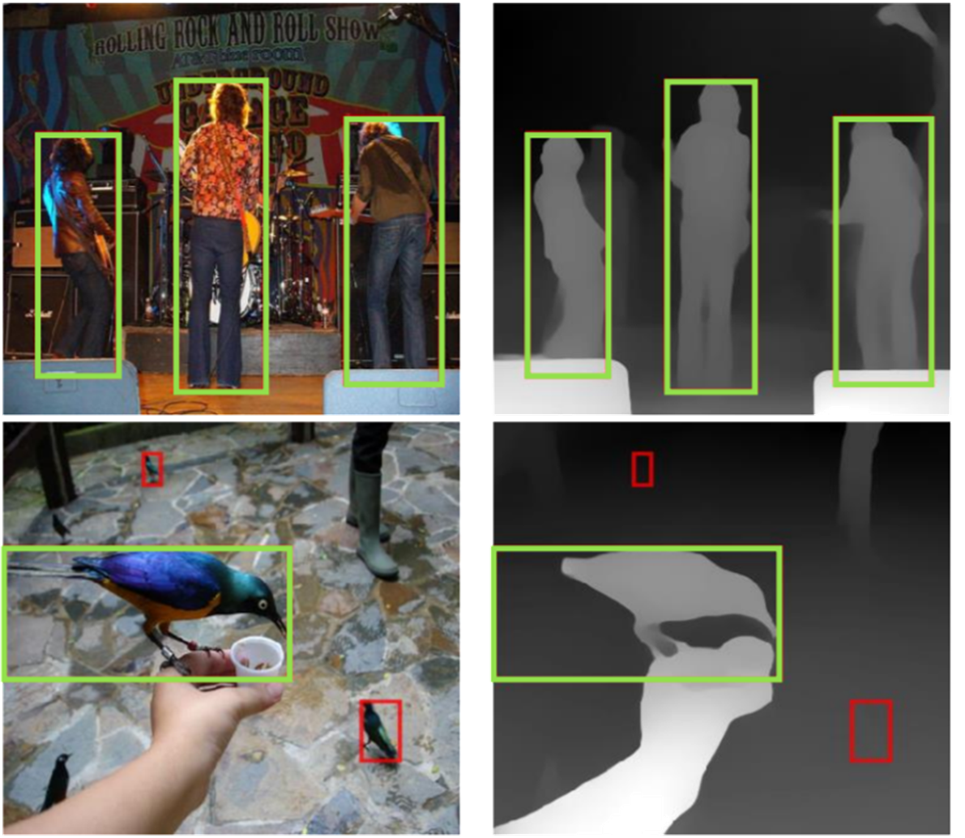
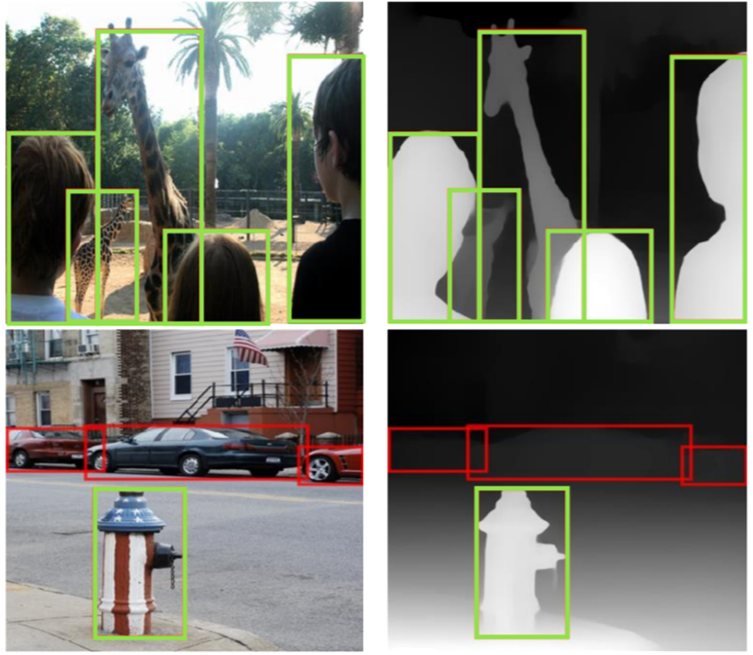
C3: Inaccurate Depth Map
Depth estimation is inaccurate
Adopt a SOTA monocular depth estimator, MiDaS [1]
Can rather worse the performance
Accurate
Inaccurate
[1] Toward Robust Monocular Depth Estimation: Mixing Datasets for Zero-shot Cross-dataset Transfer (PAMI'20)
Exploiting Scene Depth for Object Detection with Multimodal Transformers
12

Slide 13
Our Solutions
For challenge 1: Simple RGB-D fusion
A Transformer-based RGB-D fusion to capture non-linearity
For challenge 3: Inaccurate depth map
A feature refiner to focus on reliable region and channel in feature maps
For challenge 2: Low compatibility with the pretrained model
A Siamese structure shared for both modalities
Exploiting Scene Depth for Object Detection with Multimodal Transformers
13

Slide 14
MEDUSA
A new detection pipeline for the estimated depth, MEDUSA (Multimodal Estimated-Depth Unification with Self-Attention)
Exploiting Scene Depth for Object Detection with Multimodal Transformers
14

Slide 15
Main Contributions
MEDUSA benefits from depth information even for regular RGB images without requiring ground-truth depth
MEDUSA addresses the three challenges for object detection with estimated depth maps
A Siamese structure fully compatible with any pretrained backbone
A feature refiner for inaccurate depth maps
A multimodal transformer for better RGB-D fusion
Exploiting Scene Depth for Object Detection with Multimodal Transformers
15

Slide 16
Preliminary | DETR (Detection Transformer) [2]
[2] End-to-end Object Detection with transformers (ECCV'20)
Transformer-based Object Detector
A Transformer is a deep model that entirely relies on the self-attention mechanism
DETR
Pipeline
Exploiting Scene Depth for Object Detection with Multimodal Transformers
16

Slide 17
Outline
General RGB-D Detection Pipeline
Three Challenges
Proposed Detection Pipeline: MEDUSA <<
Experimental Results
Conclusion and Future Work
Exploiting Scene Depth for Object Detection with Multimodal Transformers
17

Slide 18
MEDUSA | Siamese Feature Extractor
The transferability of deep models that can learn hierarchical features even from different modalities
Gray color mapping for the depth input
Exploiting Scene Depth for Object Detection with Multimodal Transformers
18

Slide 19
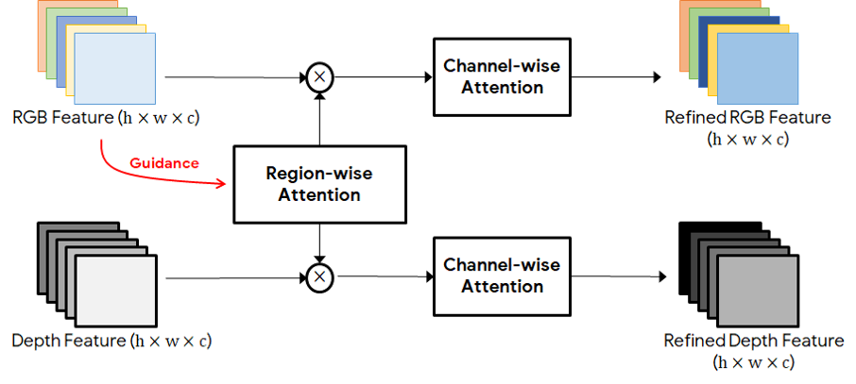
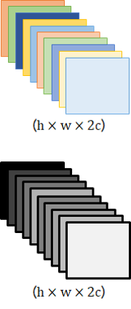
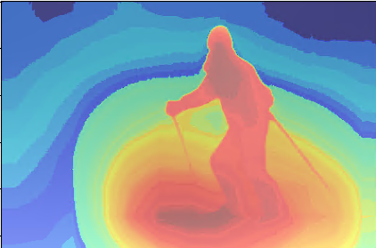
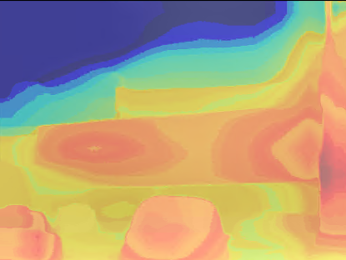
MEDUSA | Feature Refiner
A region- and channel-wise attentions to focus on reliable regions and channels
c
CIM [3]
c
[3] Select, Supplement and Focus for RGB-D Saliency Detection (CVPR’20)
Exploiting Scene Depth for Object Detection with Multimodal Transformers
19

Slide 20
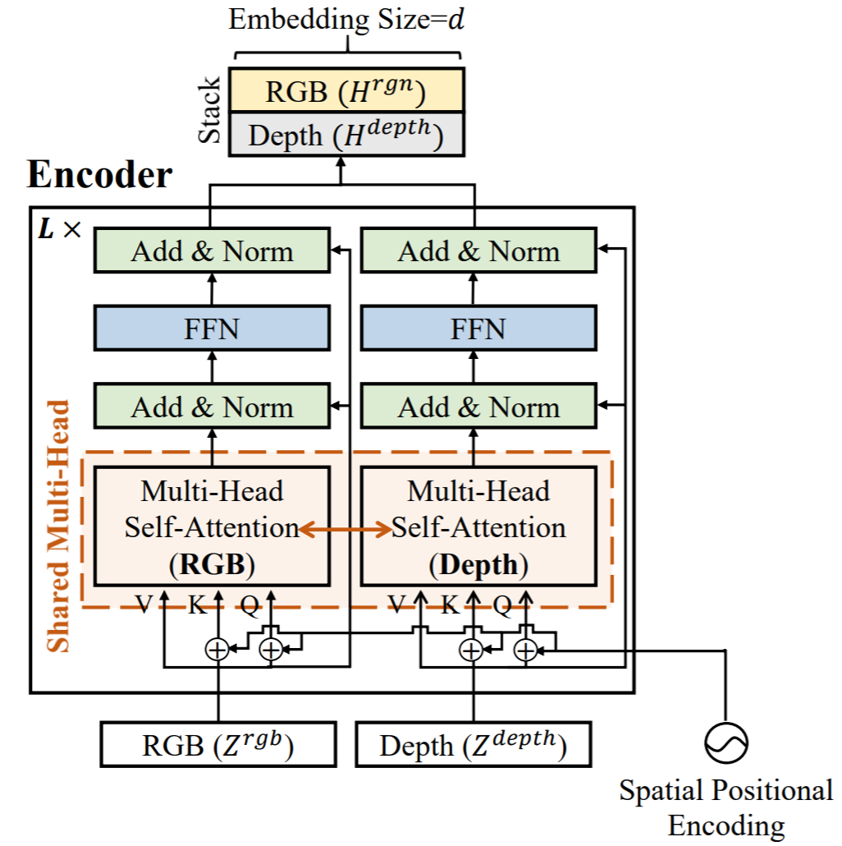
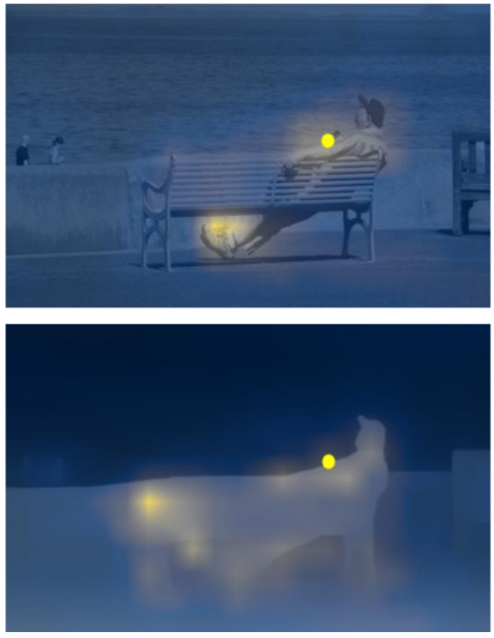
MEDUSA | Multimodal Transformer Encoder
(3)
RGB
(2)
Depth
(1)
Exploiting Scene Depth for Object Detection with Multimodal Transformers
20

Slide 21
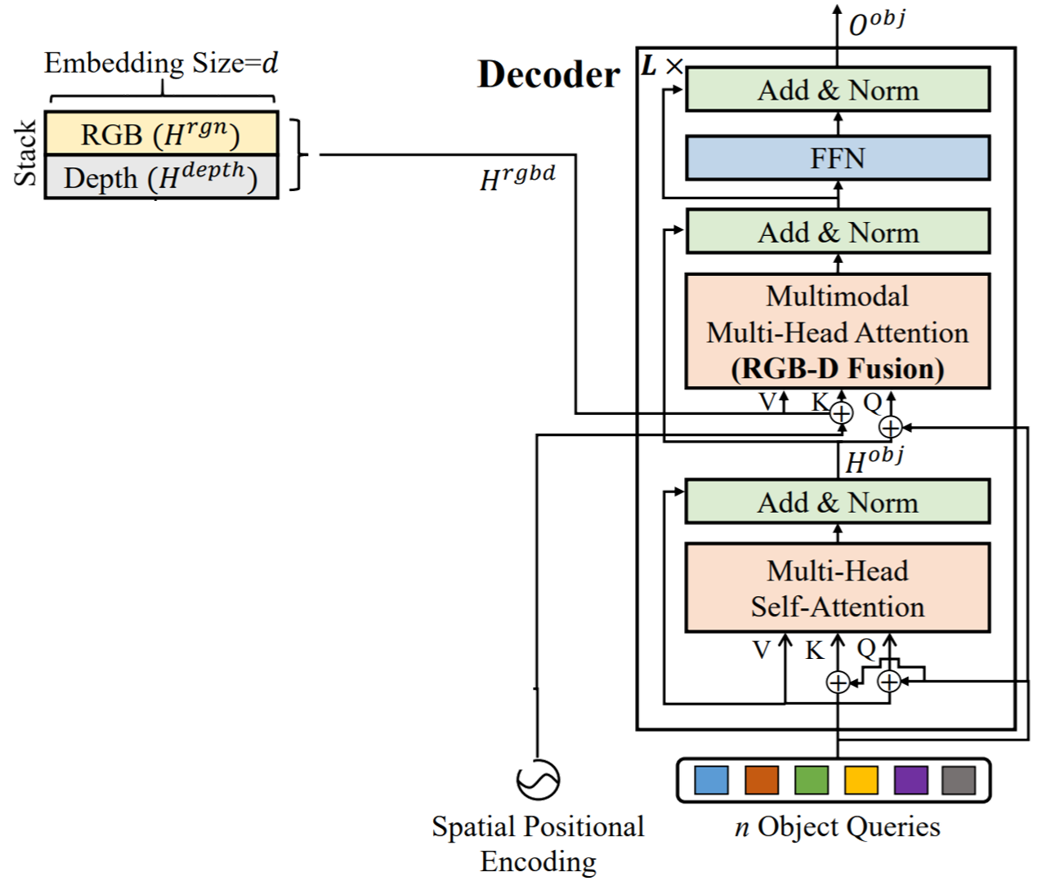
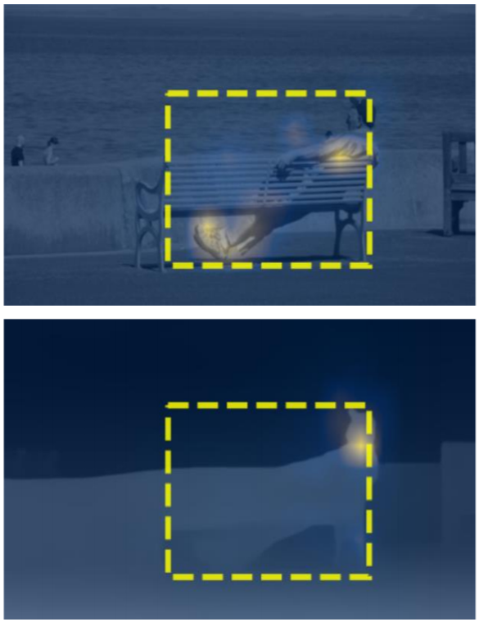
MEDUSA | Multimodal Transformer Decoder
(3)
RGB
RGB-D feature sequence
(2)
Depth
(1)
Exploiting Scene Depth for Object Detection with Multimodal Transformers
21

Slide 22
MEDUSA | Prediction and Training
Exploiting Scene Depth for Object Detection with Multimodal Transformers
22

Slide 23
Outline
General RGB-D Detection Pipeline
Three Challenges
Proposed Detection Pipeline: MEDUSA
Experimental Results <<
Conclusion and Future Work
Exploiting Scene Depth for Object Detection with Multimodal Transformers
23

Slide 24
Experimental Setting
RGB-D Datasets: VOC-RGBD and COCO-RGBD
VOC-RGBD and COCO-RGBD
Five Compared Algorithms:
DETR (Baseline, RGB-only Method)
(a) DETR with Early Fusion
(b)-(c) DETR with Late Fusion V1 and V2
MEDUSA (Our proposed Method)
Exploiting Scene Depth for Object Detection with Multimodal Transformers
24

Slide 25
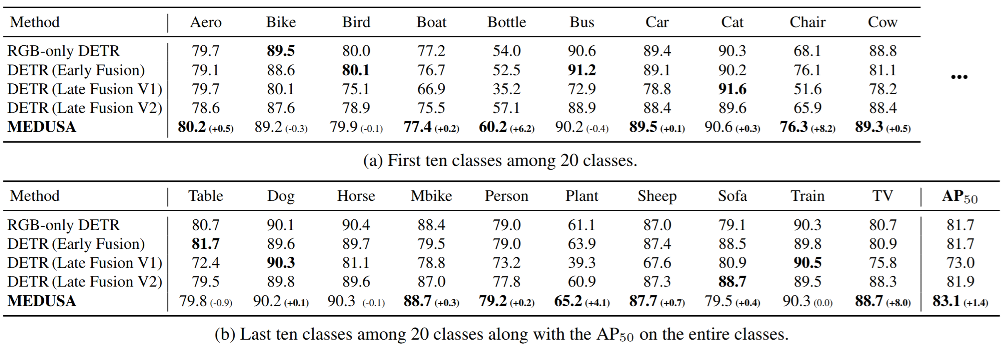
Comparison | VOC-RGBD Data
All the methods were trained for 150 epochs with 600x1000 training images
MEDUSA achieves +1.4 AP compared with the RGB-only DETR
Bottle, chair, plant, and TV classes gain remarkable benefit by 4.1-8.2AP
Exploiting Scene Depth for Object Detection with Multimodal Transformers
25

Slide 26
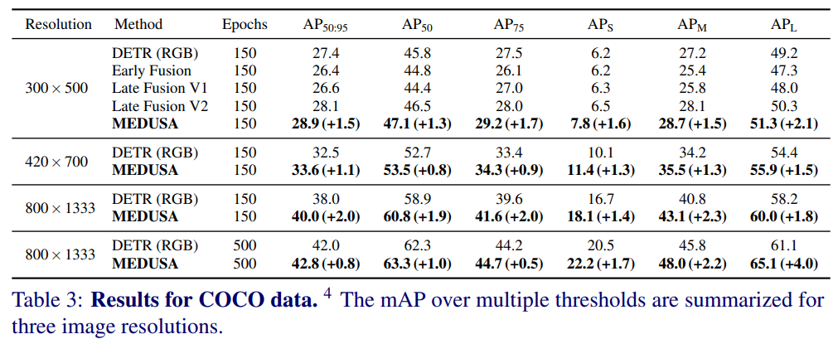
Comparison | COCO-RGBD Data
Exploiting Scene Depth for Object Detection with Multimodal Transformers
26

Slide 27
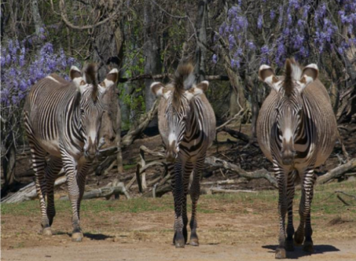
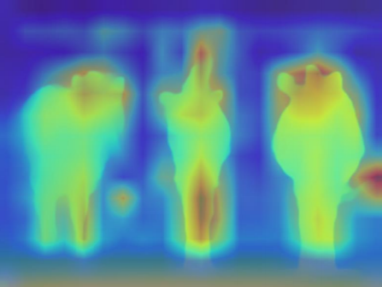
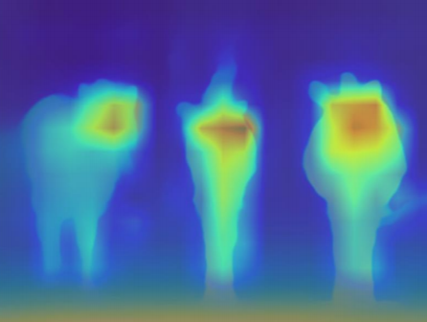
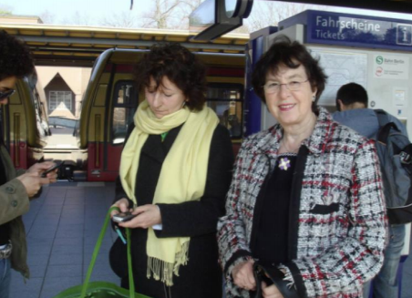
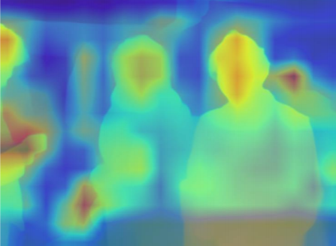
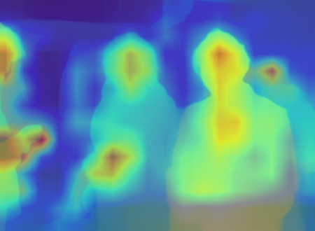
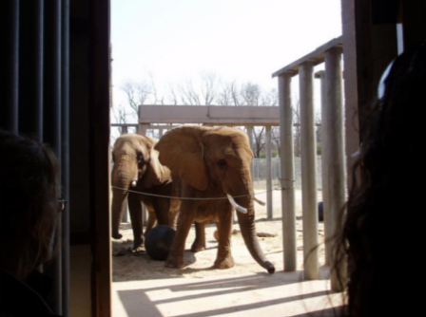
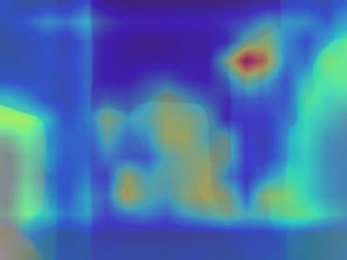
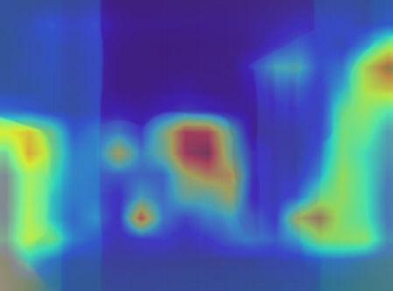
Detailed Results | Effect of the Feature Refiner
(a) Original RGB
(b) Initial Depth Feature Map
(c) Refined Depth Feature Map
Exploiting Scene Depth for Object Detection with Multimodal Transformers
27

Slide 28
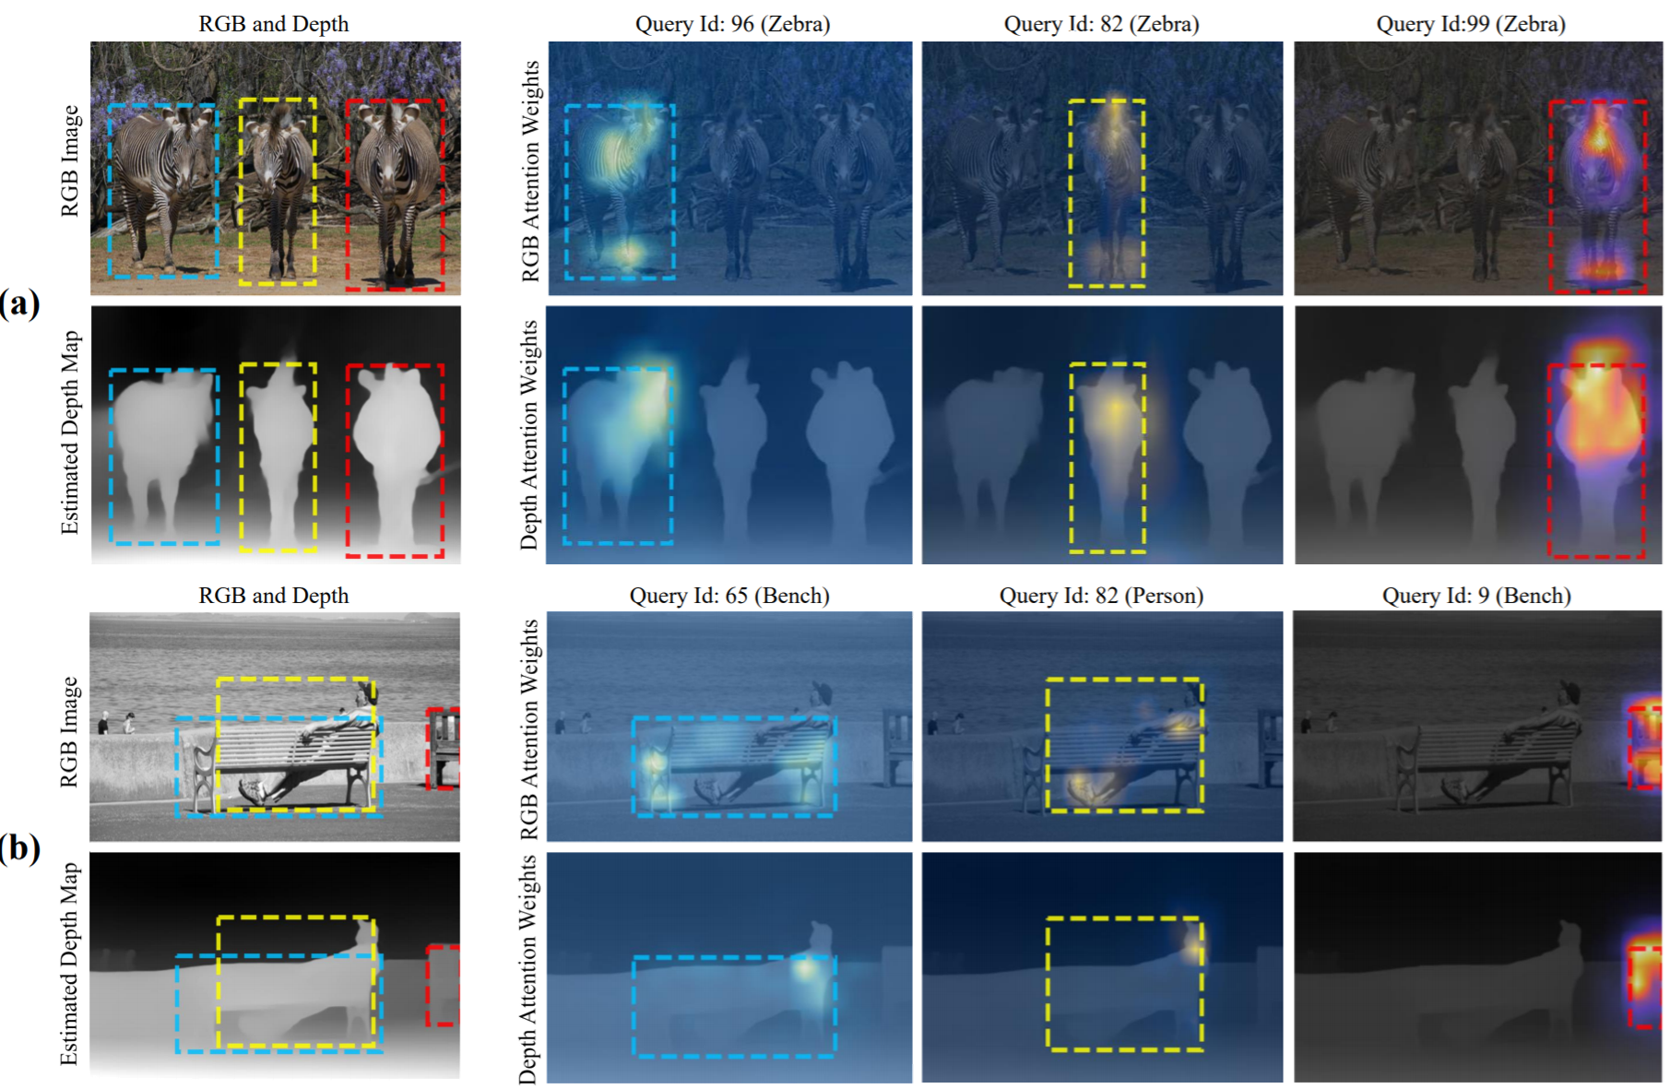
Detailed Results | Attention for RGB-D Fusion (1/2)
Exploiting Scene Depth for Object Detection with Multimodal Transformers
28

Slide 29
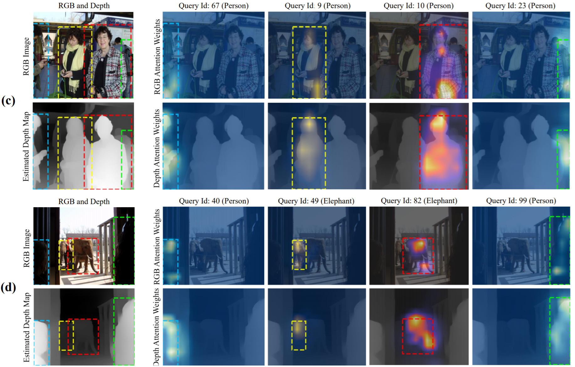
Detailed Results | Attention for RGB-D Fusion (2/2)
Exploiting Scene Depth for Object Detection with Multimodal Transformers
29

Slide 30
Outline
General RGB-D Detection Pipeline
Three Challenges
Proposed Detection Pipeline: MEDUSA
Experimental Results
Conclusion <<
Exploiting Scene Depth for Object Detection with Multimodal Transformers
30

Slide 31
Conclusion and Future Work
Conclusion
MEDUSA exploits estimated depth, and overcomes the three challenges to cope with the estimated depth
MEDUSA empirically shows that the estimated depth plays an important role, and indeed improves the performance
Exploiting Scene Depth for Object Detection with Multimodal Transformers
31

Slide 32
Thank you
Code: https://github.com/songhwanjun/MEDUSA

