Slide 1
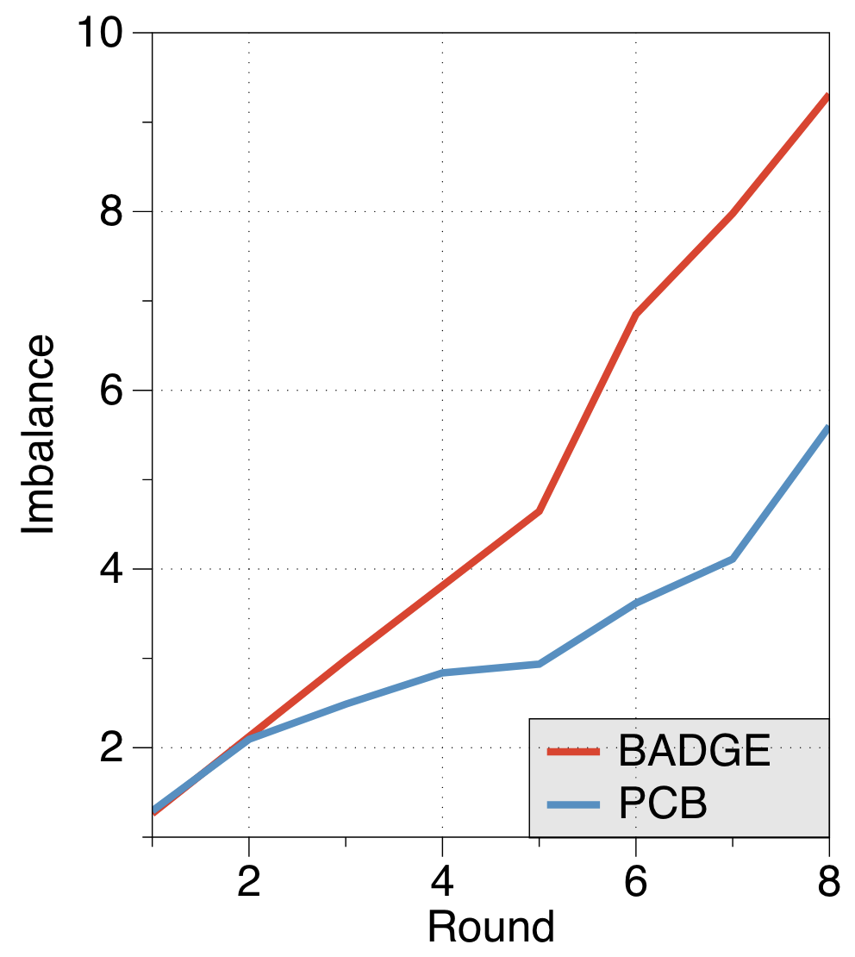
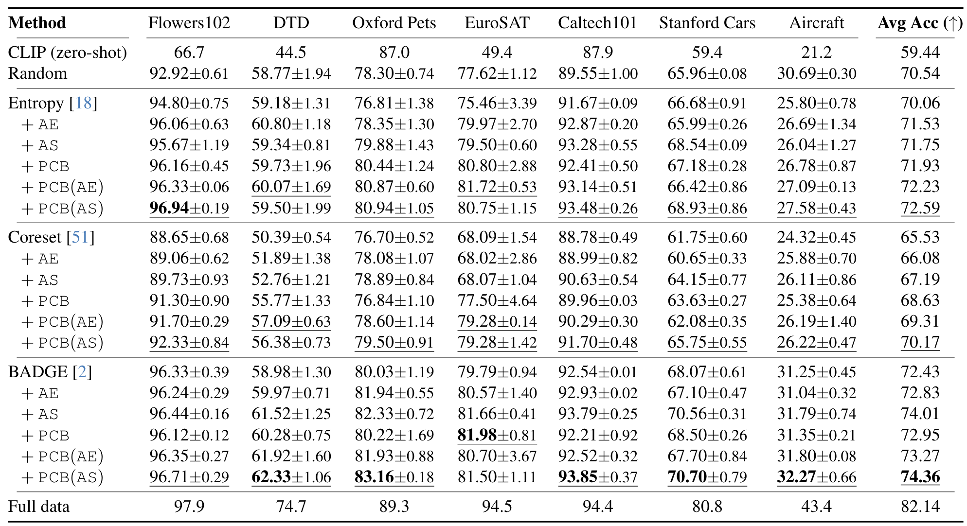
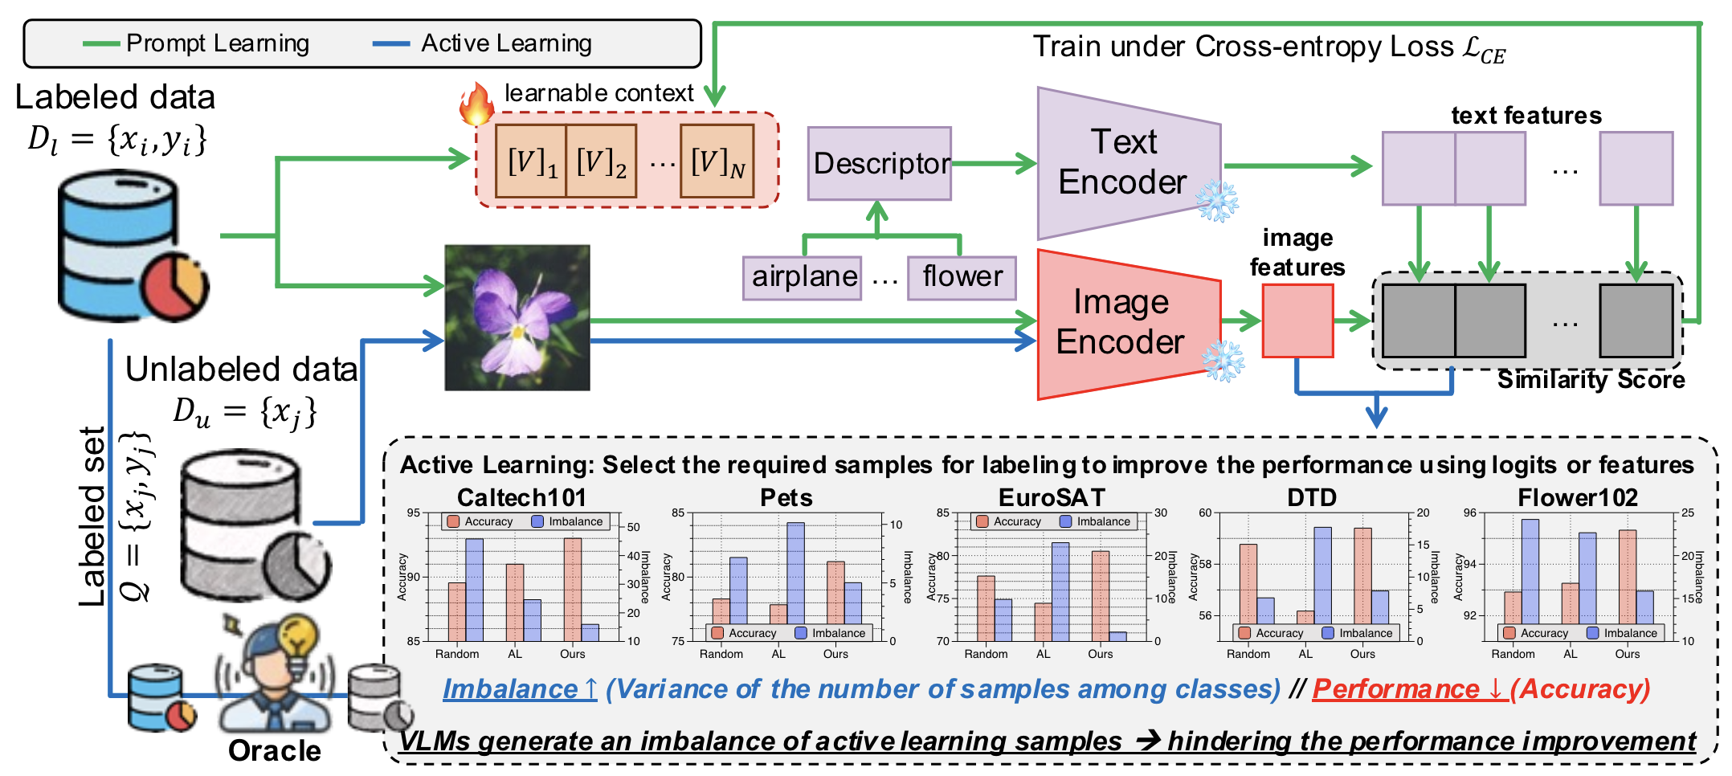
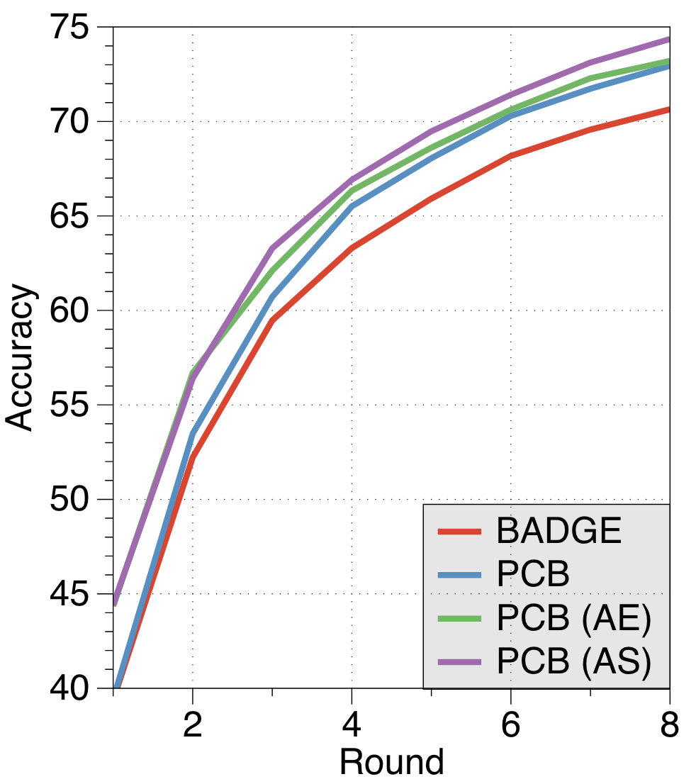
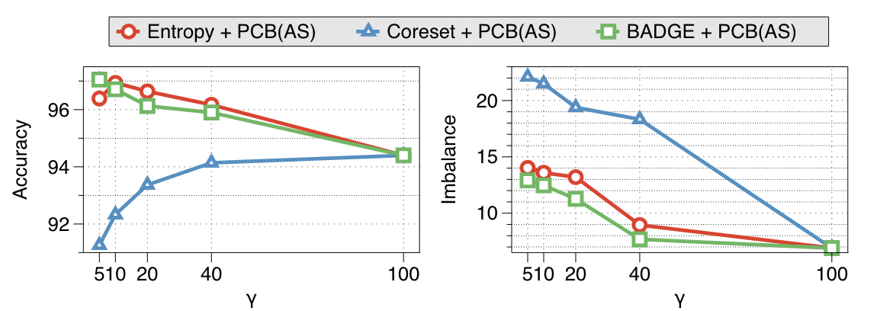
Active Prompt Learning in Visual Language Models
1
2
Jihwan Bang¹ Sumyeong Ahn² Jae-Gil Lee¹
Code
Problem Set-up
Method
Experiments
tl;dr. Active learning set-up and method for a VLM with parameter efficient finetuning
Pseudo-Class Balance Sampler (PCB)
Final Accuracy on Seven Downstream Tasks
Algorithm
(1)
INPUT: the number of samples $N$, query set $Q$, estimated labeled set $\tilde{D_{l}}$, pseudo-labeled set $\tilde{P}$
for $n=1, 2, …, N$ do
1. Select class $k$, the smallest number of class samples in $\tilde{D_{l}}$
2. Select one sample pseudo-labeled as $k$ from $\tilde{P}$
3. Update query set $Q$ by adding the selected one
4. Update estimated labeled set $\tilde{D_{l}}$
(2)
end
(1) Reducing the imbalance when constructing the query set $Q$
(2) Improving the accuracy in comparison to the active learning without PCB
Ablation: Accuracy and Imbalance in Terms of $γ$
Contributions
Prompt learning is widely used in pretrained VLMs (e.g., CLIP) to adapt to a target task.
Assumption: A few examples for all the classes are given.
Description Augmentation
How to get them from an unlabeled pool? → Active prompt learning
(1) AS: Average Similarity for each embedding
$$P\left(y=k \right|x)= \frac{1}{δ_{k}}\sum_{i=1}^{δ_{k}}{P\left(y=k | x, d_{k}^{i}\right)}$$
In this active prompt learning set-up, traditional active learning has severe performance degradation.
$$P\left(y=k | x, d_{k}^{i}\right)= \frac{\exp{({\cos{(e_{img}, e_{txt}^{k, i})}}/τ)}}{\sum_{i=1}^{K}{\sum_{j=1}^{δ_{k}}{\exp{({\cos{(e_{img}, e_{txt}^{k, i})}}/τ)}}}}$$
(# selected samples / # unlabeled samples) $×$ 100
Summary
Findings: Class imbalance in active learning queries makes VLMs more biased.
(2) AE: Average Embedding first and calculate similarity
VLMs have knowledge imbalance, causing class imbalance in active learning queries.
PCB leverages VLM knowledge to address class imbalance.
PCB triggers new active prompt learning research in VLMs.
→ Our novel method, PCB, rectifies the imbalance problem and seamlessly integrates with conventional active learning methods.
$$e_{txt}^{k}= \frac{1}{δ_{k}}\sum_{i=1}^{δ_{k}}{e_{txt}^{k, i}}$$
$P\left(y=k \right|x)=\frac{\exp{({\cos{(e_{img}, e_{txt}^{k}})}/τ)}}{\sum_{i=1}^{K}{\exp{({\cos{(e_{img}, e_{txt}^{i}})}/τ)}}}$ ,

